Slide 1
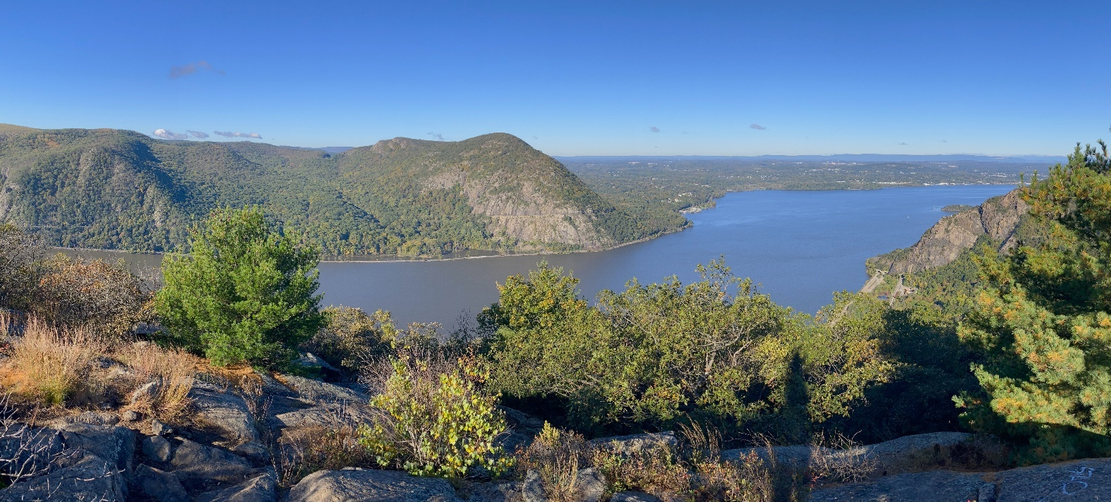
A Virtual Checkup of a River’s Vital Signs
Using Remotely Sensed Data in the Classroom
Hudson River Estuary Program
Notes:
Title slide.

Slide 2
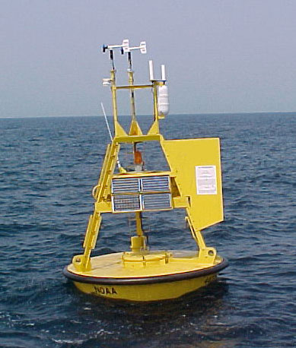
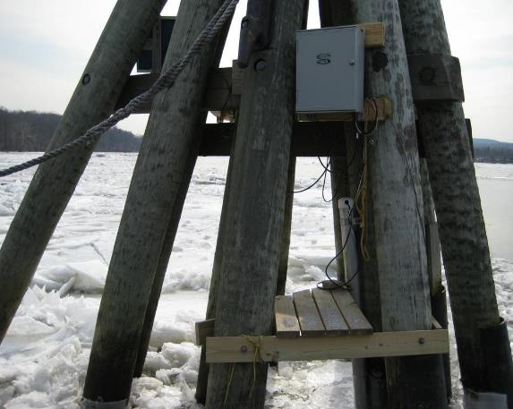
Remote sensing networks
Collect data 24/7, 365 days a year
Transmit to the World Wide Web
National Oceanic & Atmospheric Administration
Hudson River National Estuarine Research Reserve
Notes:
Remote sensing networks collect data 24/7, 365 days a year and transmit it to the World Wide Web.

Slide 3
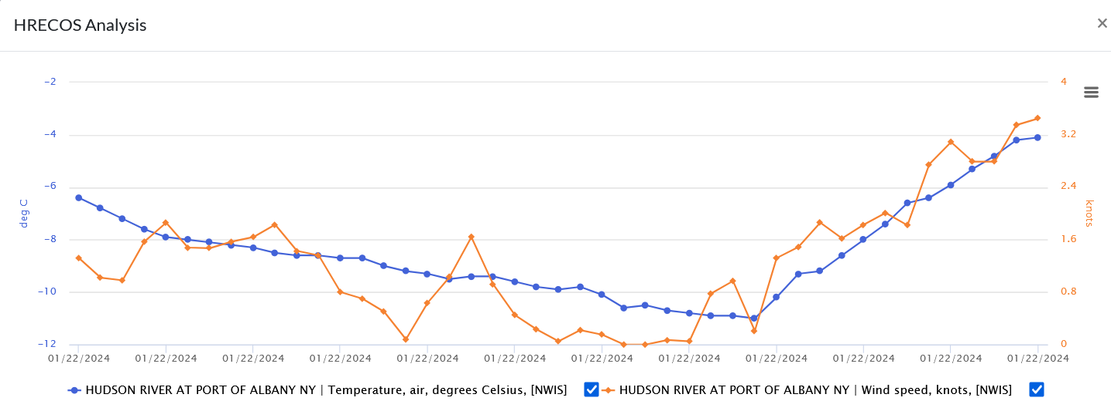
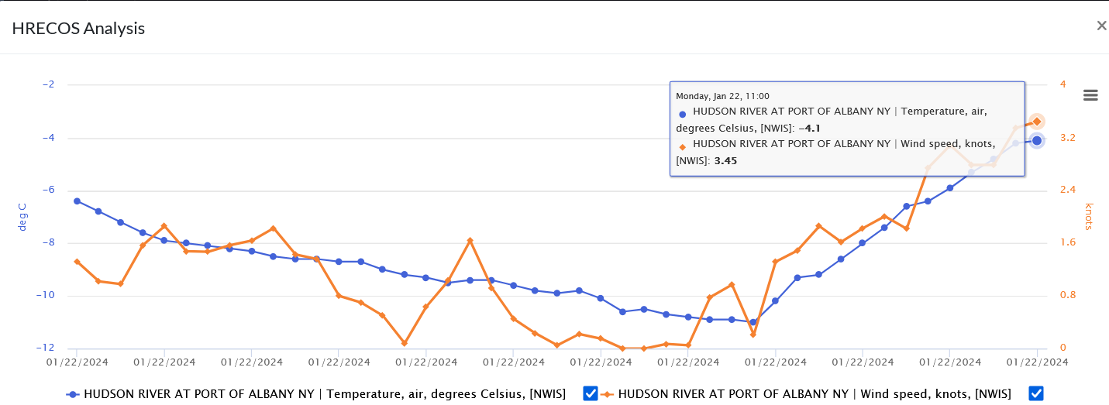
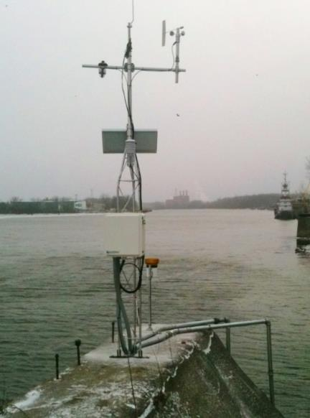
1. Remote sensing can
provide near-real time data
NYSDEC
Notes:
The photo shows the Hudson River Environmental Conditions Observing System (HRECOS) station at Albany. CLICK The sensors at this station take readings every 15 minutes, as shown by the dots on this graph. These data are transmitted to the HRECOS website, which allows users to display the data in a graph; this one shows air temperature and wind speed at Albany on January 22, 2024. CLICK This graph was called up shortly after 11:00 AM. At that time the most recent readings available were those made at 11, as shown in the pop up box revealed by positioning a cursor over the last dot.

Slide 4
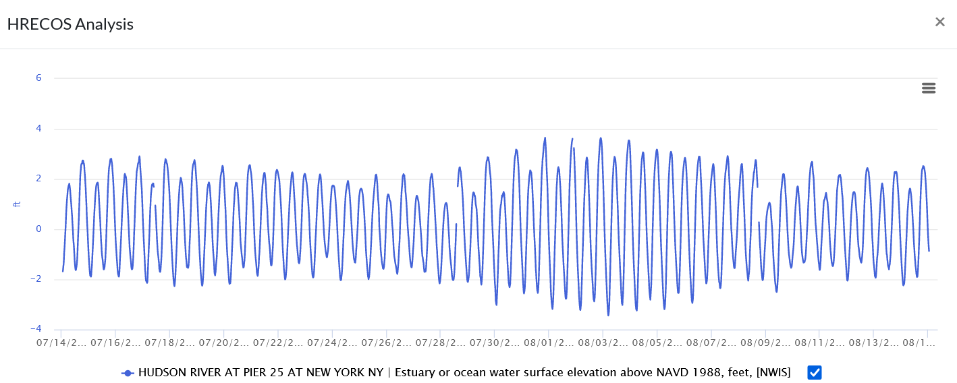




2. Remote sensing data can show cycles
4.8 ft
3.0 ft
6.7 ft
3.1 ft
Notes:
This graph covers nearly a month, the length of the lunar cycle. It shows water level as depth; the twice daily high and low tides are visible. Tide heights vary quite a bit. So does the tidal range – the difference between high and low tide heights. Tidal range varies based on the lunar cycle. Neap tides are less extreme – they occur at first and last quarter moons because the gravitational pulls of the moon and sun are at right angles then. Spring tides are more extreme – they occur at new and full moons, when the moon and sun are in a line with earth, and their gravitational pulls are working together. CLICK 4x to see the moon phases and the range (in feet) between the high and low tides at the times of neap and spring tides. Note: Depending on the parameters selected, the graph legend may cite a datum, a standard reference against which the parameter is measured. In this case it’s NAVD 1988, the North American Vertical Datum of 1988 from which measurements of height are made.

Slide 5
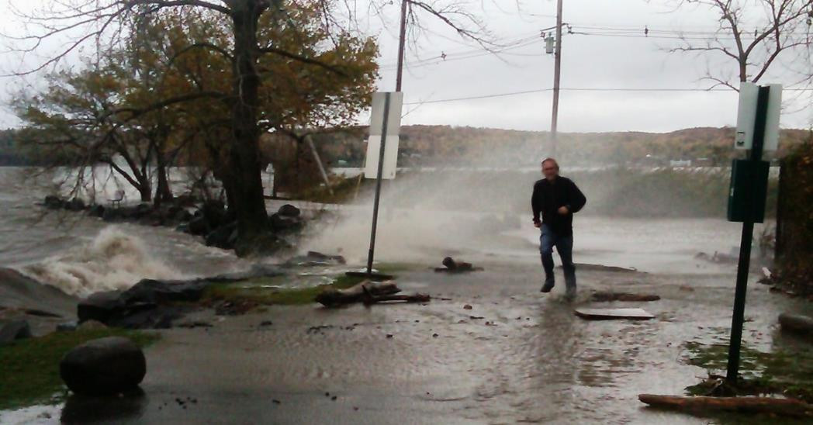
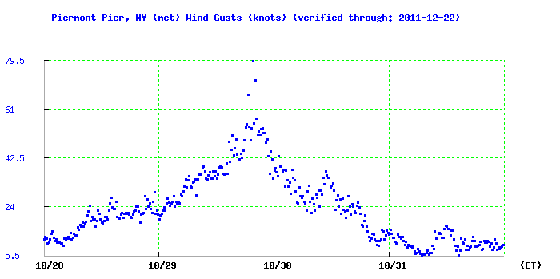
3. Remote sensing can provide
data in unsafe or inclement conditions
Lamont Doherty Earth Observatory
Notes:
The graph shows wind gusts at the end of the Piermont Pier during Hurricane Sandy. 79.5 knots equals about 91 miles per hour. CLICK to see picture of conditions on the pier before the storm reached its peak.
Historical data can be accessed through many remote sensing systems, allowing one to view the impacts of past events such as Sandy.

Slide 6
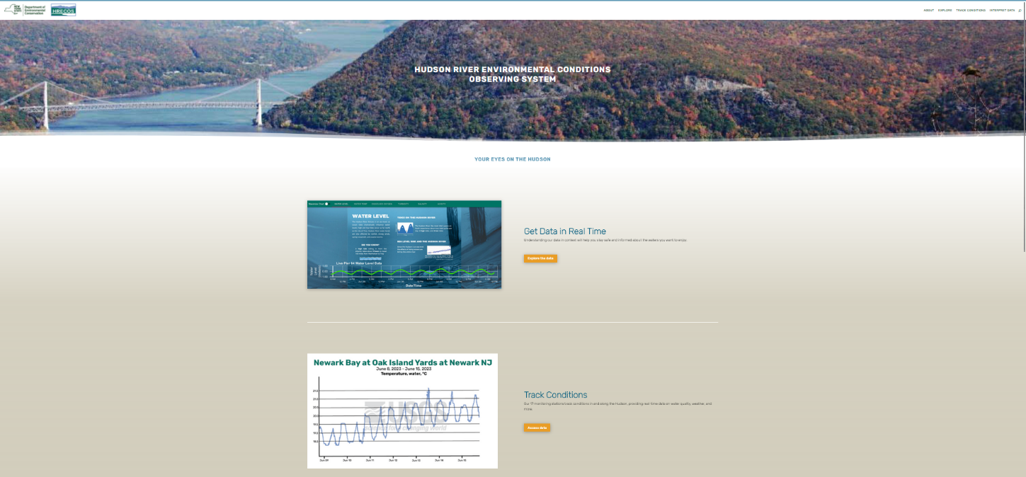
Using HRECOS
Hudson River Environmental Conditions Observing System
Notes:
This is a screenshot of the HRECOS home page with links to various resources available on the website.

Slide 7
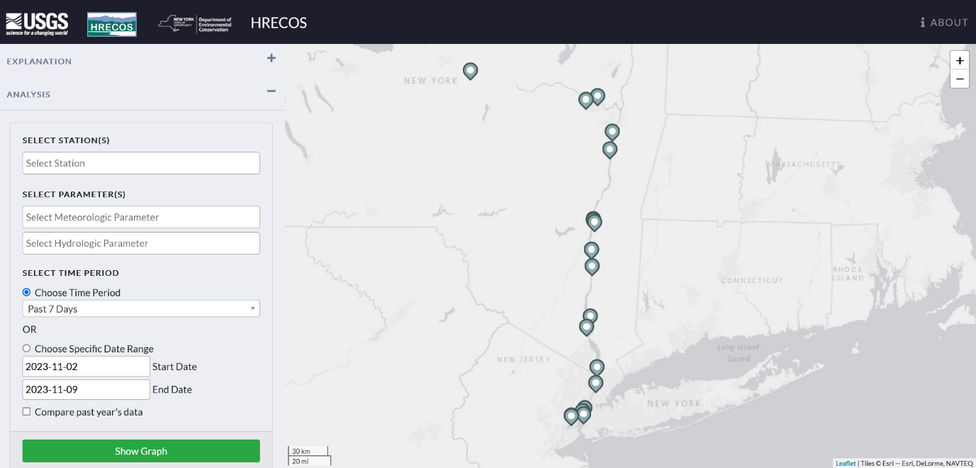
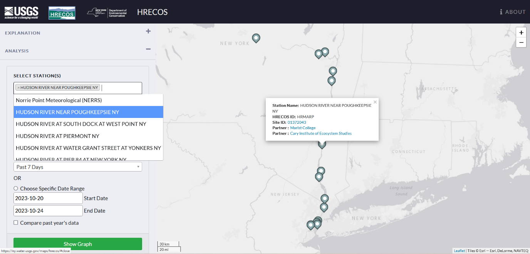
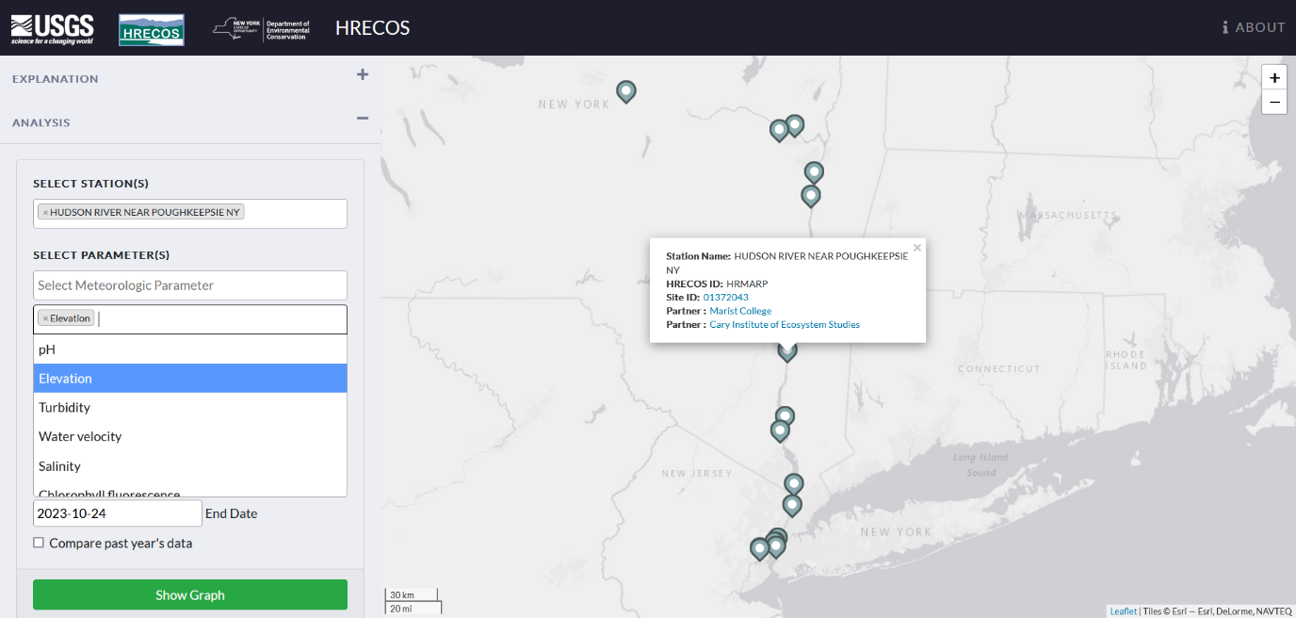
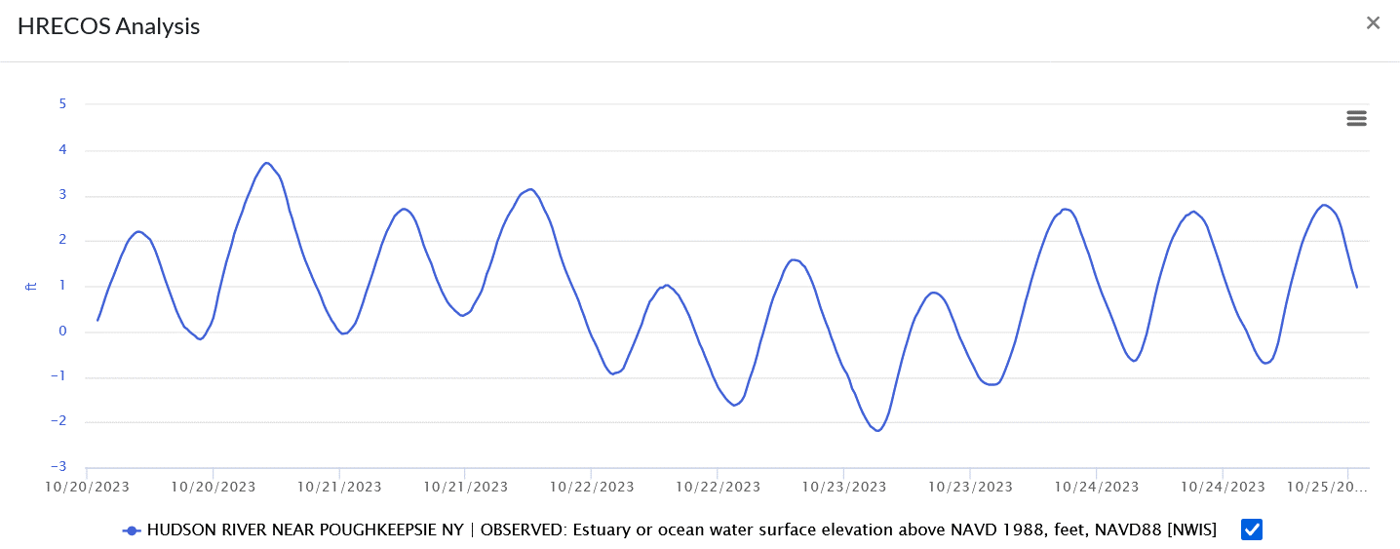
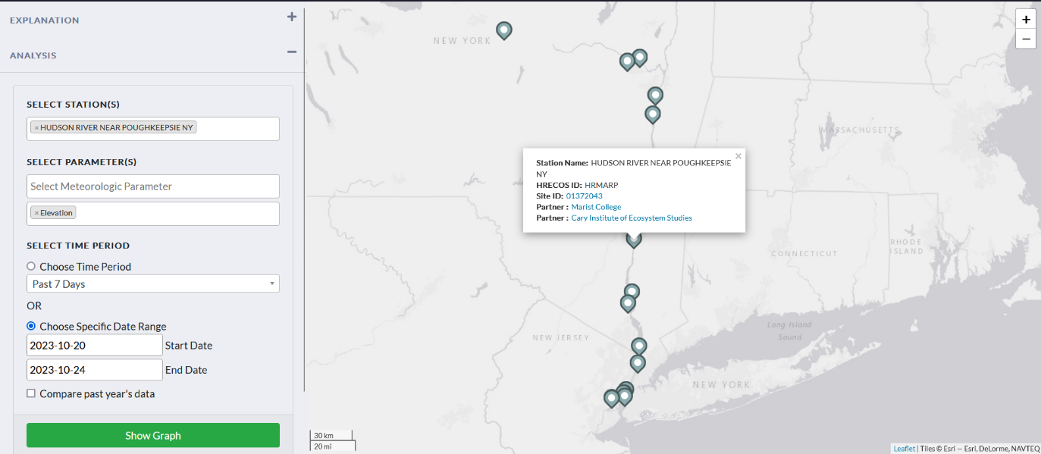
HRECOS Current Conditions page
Click on Select boxes for dropdown menus to choose station(s), parameter(s), & time period. For example, select Poughkeepsie, Elevation as the Hydrologic parameter, Choose Specific Date Range, and enter 2023-10-20 to 2023-10-24. Click on Show Graph.
What causes the ups and downs in water elevation?
High & Low Tides.
Notes:
This screen shot shows the HRECOS current conditions page. If desired, click on the hyperlink in the title to go to this HRECOS interface. Then manipulate it to see the capabilities of the system. In the example shown in this slide’s screenshots, CLICK to show selection of Station (Poughkeepsie). CLICK again to show selection of Hydrologic Parameter (elevation = water level). CLICK a third time to show selection of a specific date range (2023-10-20 to 2023-10-24). CLICK Now click on Show Graph. CLICK Note the rising and falling pattern of water elevation. Ask students what causes that pattern. CLICK to show answer: high and low tides; more on that later. Note: Water level may be indicated by Gage Height or Elevation parameters. The latter is used where elevations have been surveyed to actual sea level; that is not the case for data shown by selecting the Gage Height parameter. Older water level data at some stations may be limited to Gage Height. Note: A more detailed map of HRECOS station sites is available; see Appendix Slide 1

Slide 8
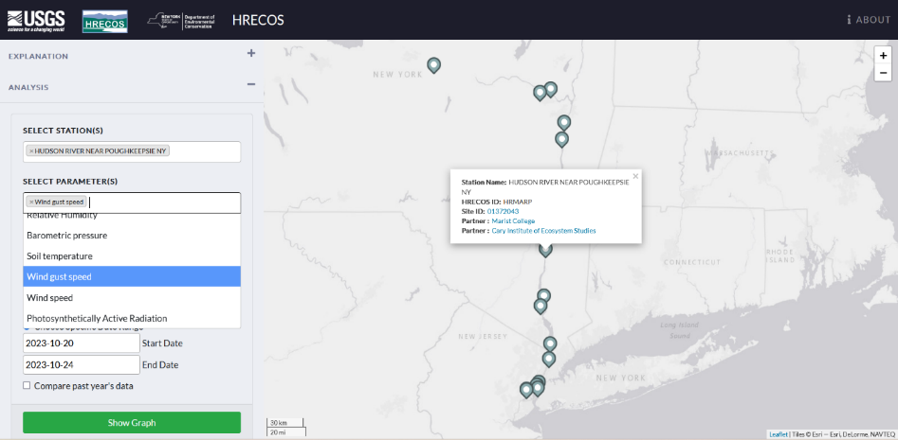
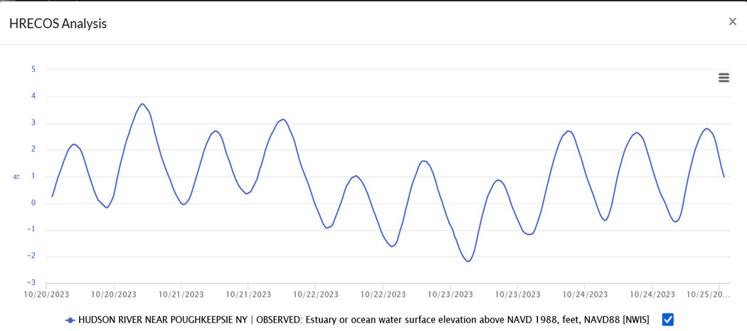
HRECOS Current Conditions page
Digging deeper
Strong winds can sometimes impact water levels in the Hudson. Select wind gusts from the meteorological parameter menu and show graph.
Water elevations 10/22-10/23 were lower than on days before and after. Compare data for other stations and parameters to see why.
Notes:
The HRECOS interface allows users to compare data for different stations and to look at how parameters might influence one another. Water elevations 10/22-10/23 were lower than on days before and after. Compare data for other parameters and stations to see why. CLICK to view the interface and selection of wind gusts from the meteorological parameters. Strong winds can sometimes impact water levels in the Hudson. CLICK for next slide.

Slide 9
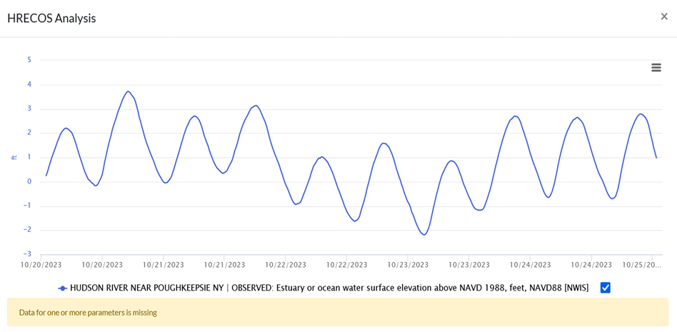
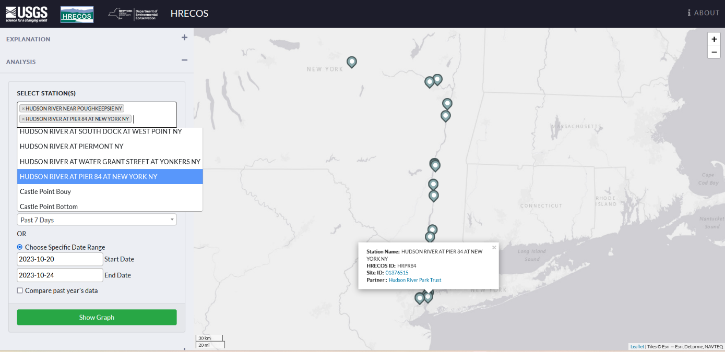
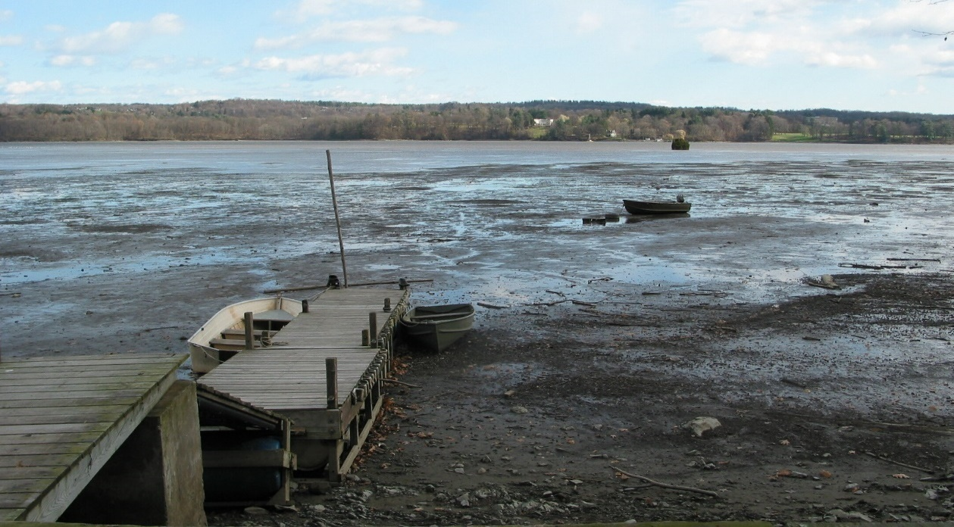
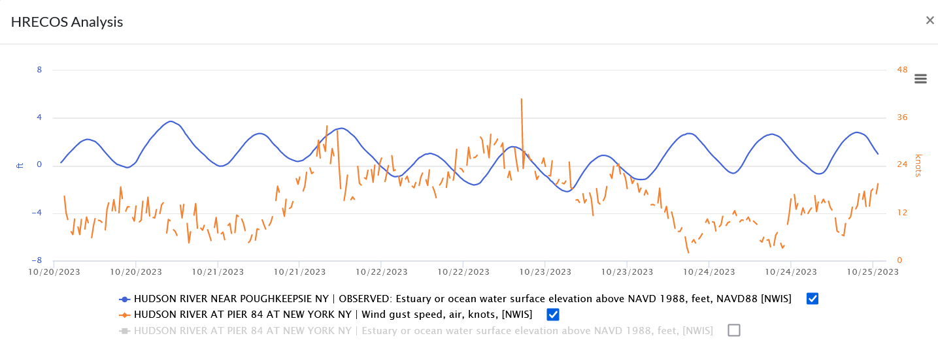
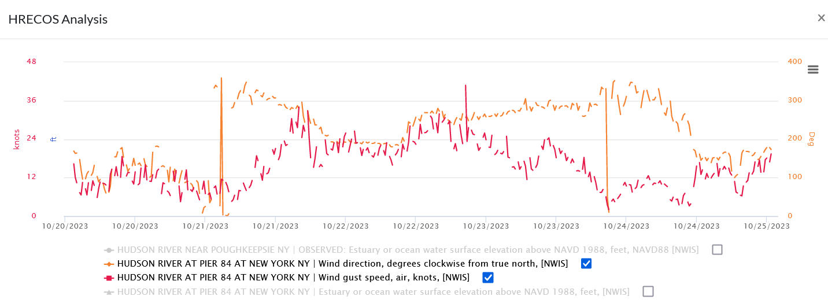
HRECOS Current Conditions page
Digging deeper
Wind direction (in degrees from north and now the orange plot) was mainly from the west and north.
Data is missing because the Poughkeepsie station lacks an anemometer. Other stations have them. Select Pier 84 at New York and show graph.
Wind gusts (orange plot) averaged 20-30 knots (23-35 miles per hour) over 10/22-10/23.
Let’s add wind direction to the graph.
Lengthy periods of strong west to north winds push water down the river and away from the seacoast, lowering water levels in the Hudson.
When extreme, these are called blowout tides.
Notes:
Data is missing because the Poughkeepsie station lacks an anemometer to measure wind speed. Other stations have them. CLICK Select Pier 84 at New York. CLICK Show graph. (Note: Plots of some selected parameters have been left out to simplify this and some subsequent graphs. Those parameters are grayed out in the graph legends). Wind gusts (orange plot) averaged 20-30 knots (23-35 miles per hour) over 10/22-10/23. Let’s add wind direction to the graph. CLICK Wind direction (in degrees from north and now the orange plot) was mainly from the west and north. CLICK Lengthy periods of strong west to north winds push water down the river and away from the seacoast, lowering water levels in the Hudson. CLICK When extreme, as shown here at Esopus Meadows in Ulster County, these are called blowout tides.
Note: The missing data message appears most often when a station is not equipped with the sensor necessary to measure the chosen parameter or when it was offline on the dates requested. Depending on the station, the parameters measured and the period of record can be determined by going to the US Geological Survey or NOAA National Estuarine Research Reserve System data interface. Select a site from the Station dropdown menu or click on the site icon shown on the map, and then on the Site ID number (for USGS) or the NERRS link in the pop-up window. See Appendix Slides 2 and 3 for detailed explanations.

Slide 10
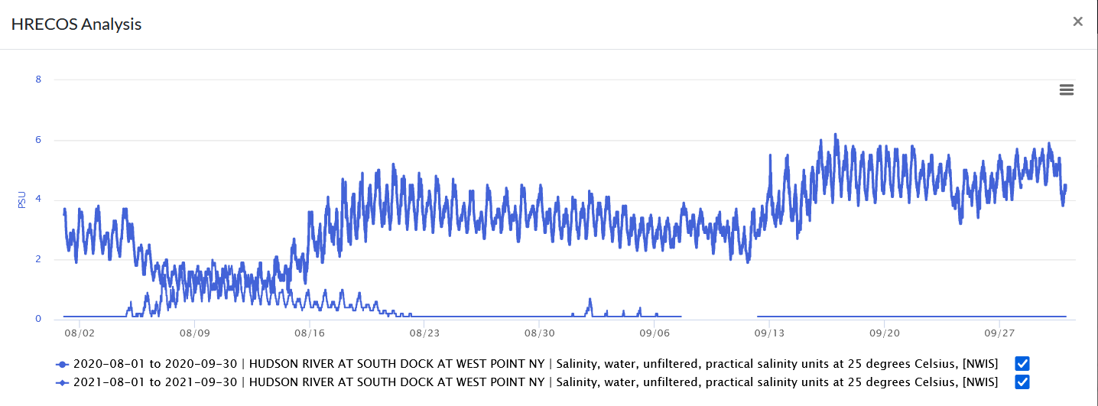
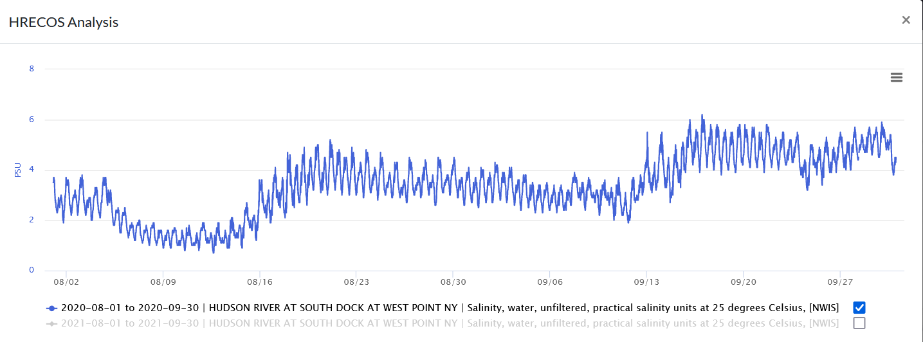
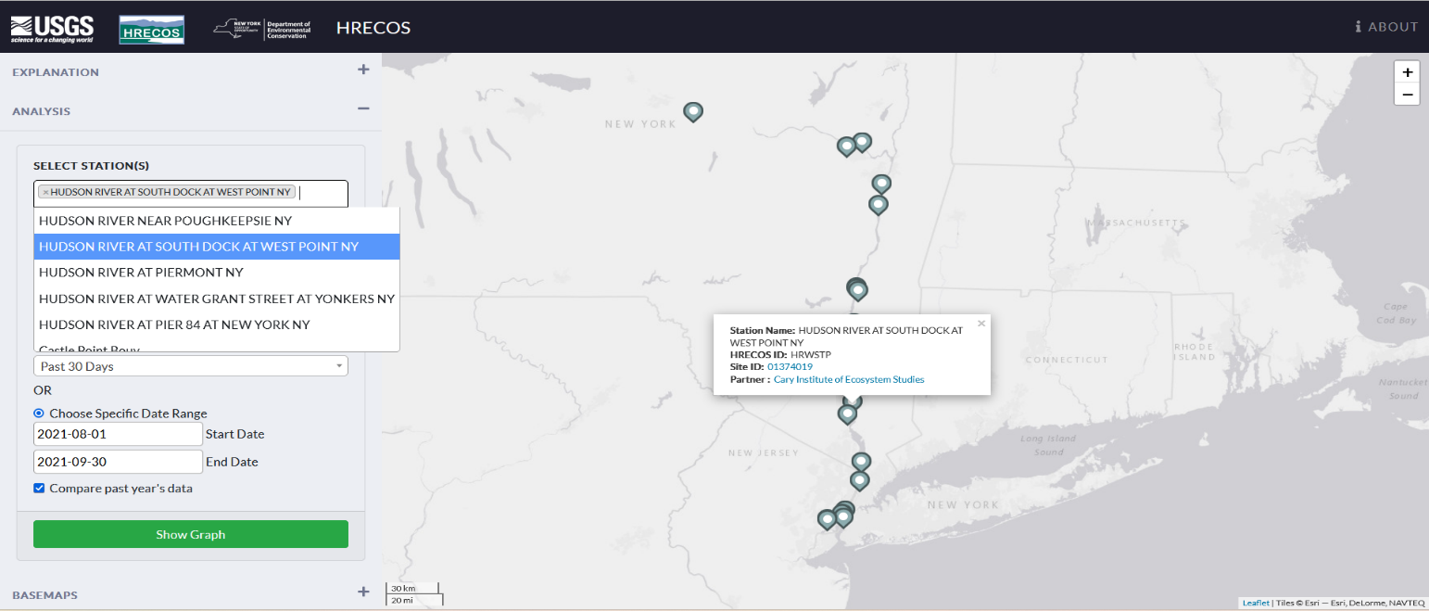
HRECOS Current Conditions page
Compare years
Select station, parameter, and time period – in this example , salinity at South Dock at West Point from 8/1/21-9/30/21. Check the “Compare past year’s data” box, then show graph.
The plots of the two years are the same color. Unchecking the box for 2021 leaves out that year and shows only the 2020 salinity, which is much higher. Why might that be the case?
Notes:
To compare years, select station, parameter, and time period – in this example , salinity at South Dock at West Point from 8/1/21-9/30/21. Check the “Compare past year’s data” box, then show graph. CLICK The plots of the two years are the same color. Unchecking the box for 2021 CLICK leaves out that year and shows only the 2020 salinity, which is much higher. Why might that be the case? Leave the question open for now, to be explored later in the PowerPoint.

Slide 11
A few helpful hints for using HRECOS
Not all parameters – weather data in particular – are measured at all stations. Look for desired data at another station.
Many phenomena are driven by events over the ocean or in the watershed, it can be useful to check relevant data from stations at either end of the estuary – Albany or NYC – even if the graph shown is from a mid-river site.
Gaps or hiccups in the data occur due to equipment problems, extreme events, or when a station was added to the network. It can be useful to check the metadata information for each site.
Notes:
Like any system, perfection in these remote-sensing networks is elusive. A station might be missing data due to technical problems, or the recorded data might be flagged as suspicious if such issues are suspected. Most remote-sensing networks will have provisos indicating that the data presented are preliminary or unverified pending examination by a person overseeing the station.
In some cases, the phenomenon shown in the graph can be observed at other HRECOS sites. Station locations are shown in the map on the Current Conditions page. A more detailed map is available; see Appendix Slide 1. Appendix Slides 2 and 3 explain how to access metadata.

Slide 12
HRECOS Stories
Use HRECOS to promote graph interpretation skills.
Use graphs to tell stories of river phenomena, using historical data.
Have students propose hypotheses to explain the phenomena.
Have students test hypotheses by checking other parameters that might be causing the phenomena.
When extreme events (hurricanes, nor’easters, etc.) are forecast, predict likely impacts and then look to see what happens using HRECOS during/after the event.

Slide 13
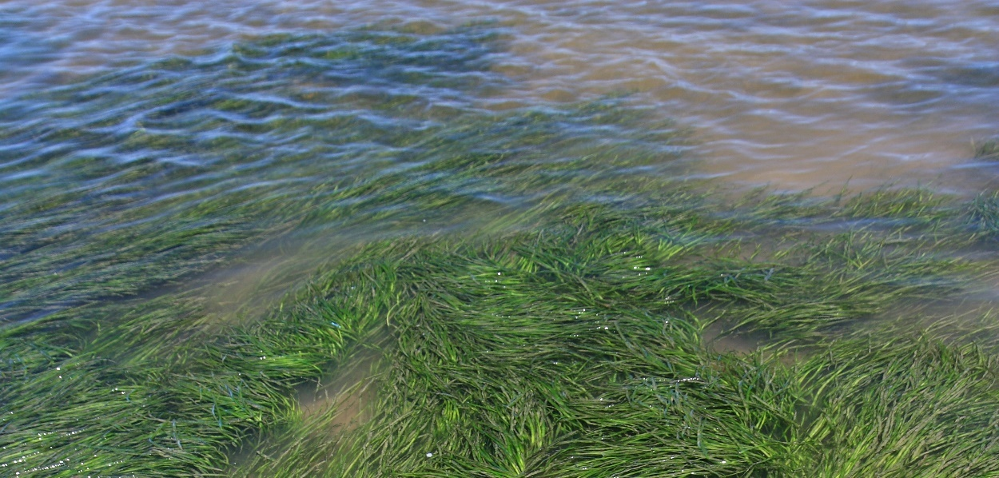
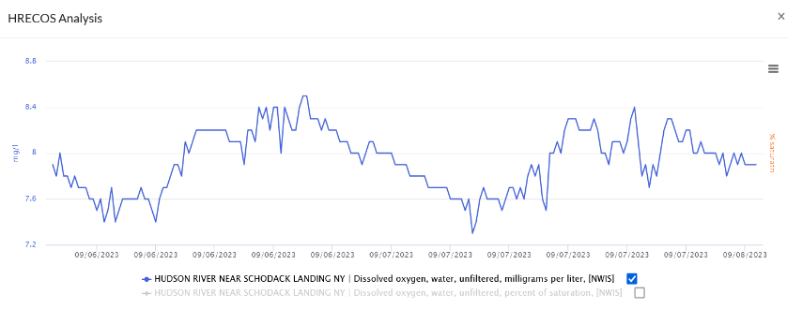
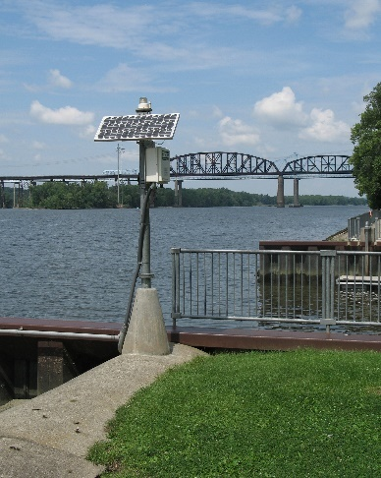
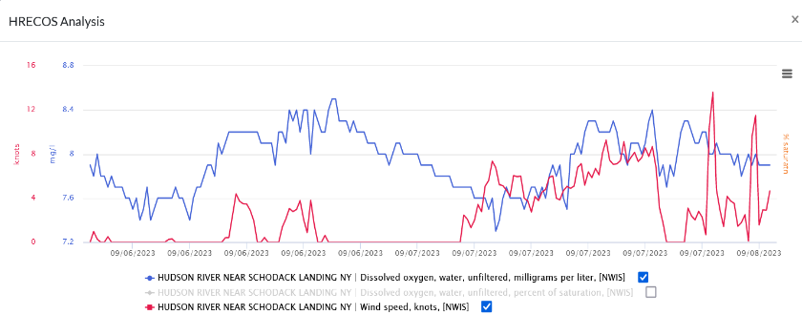
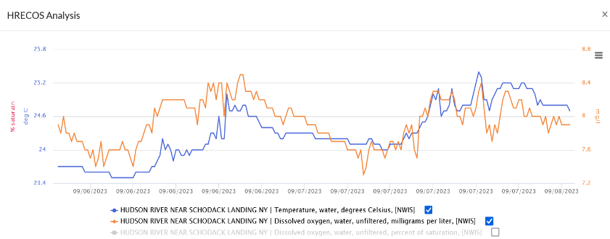
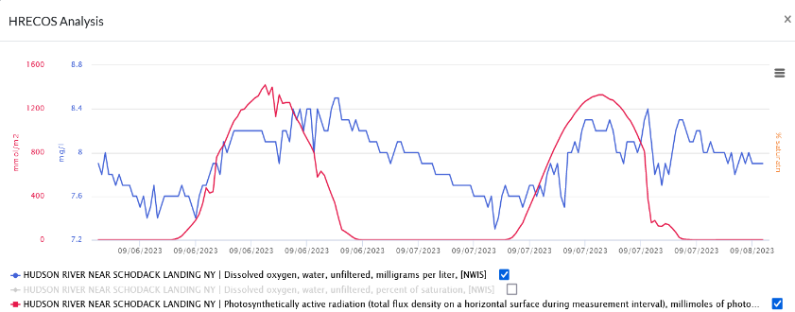
Case Study #1: 24 hour DO cycles
Wind?
What is the pattern in this graph?
Is it caused by …
Temperature?
Sunlight?
Sunlight
Notes:
Ask students how oxygen (molecular oxygen - O₂, not the atom of O in H₂O) gets into the water: diffusion from the atmosphere, maybe aided by winds; photosynthesis by aquatic plants and phytoplankton; inputs from tributaries. What pattern do they see in this graph of dissolved oxygen (DO) at Schodack Landing in September 2023? DO levels rise from morning into mid-afternoon and fall through late afternoon and overnight. CLICK What causes that pattern? CLICK through a number of hypotheses: wind, temperature, and sunlight. In each case, a graph appears with plots of both DO and the parameter in question. Winds might be a factor on 9/7, but DO levels are just as high on 9/6 with less wind. CLICK Temperatures rise with DO into the afternoon, but since warmer water holds less DO than cold water, it doesn’t make sense that rising temperatures would directly impact DO levels. CLICK What about sunlight (reported as photosynthetically active radiation in HRECOS)? A clear correlation. Why? CLICK Sunlight promotes photosynthesis by submerged aquatic plants and phytoplankton, which produces oxygen.

Slide 14
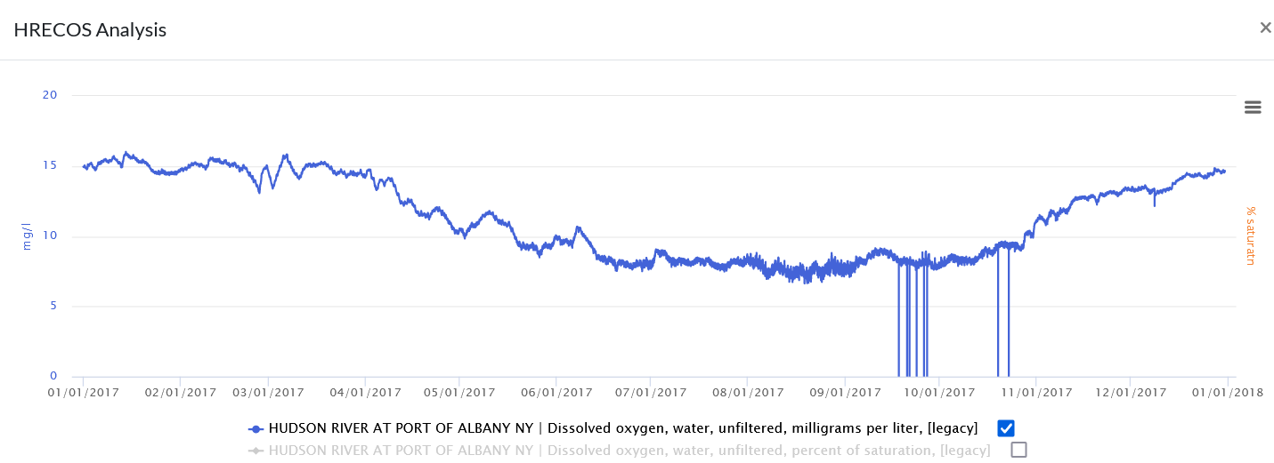
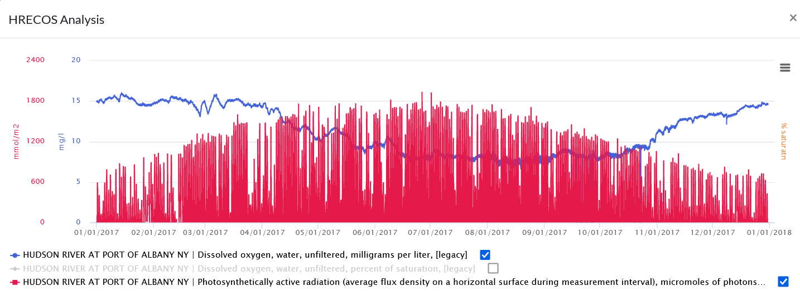
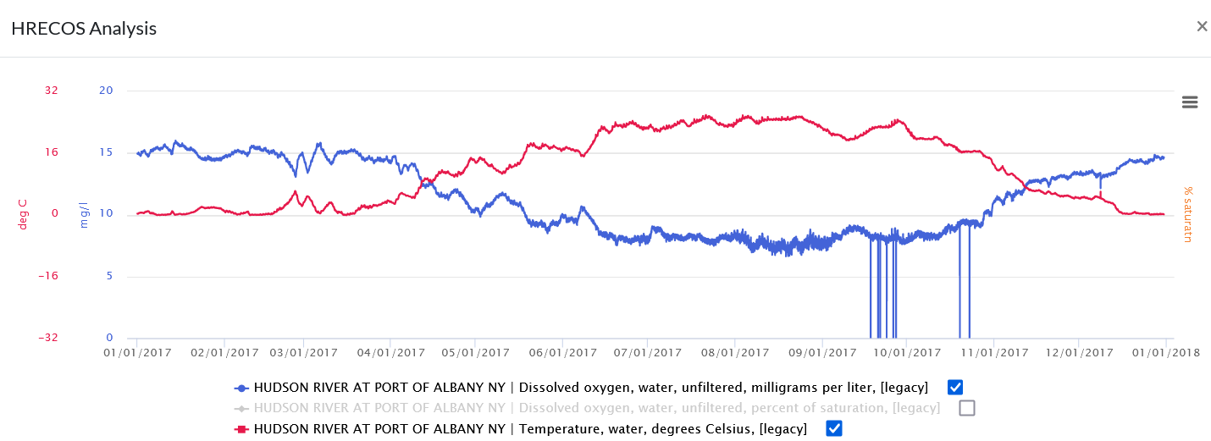
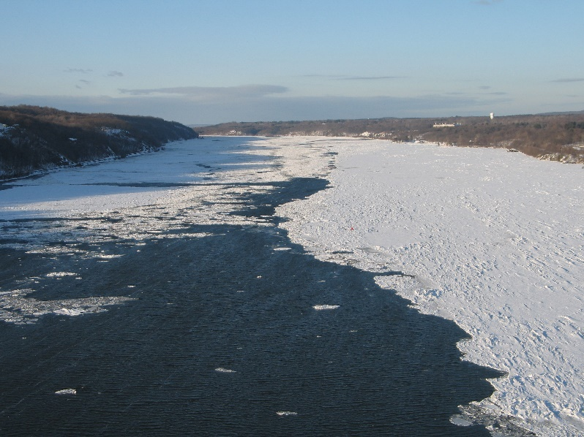
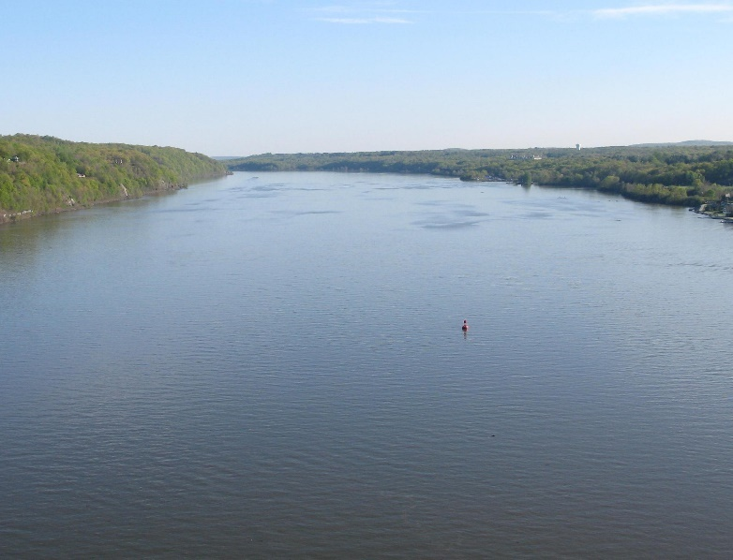
Case Study #2: Annual DO levels
What would a graph of DO levels over a year look like?
More sunlight in summer, but less DO.
Cold water holds more DO than warm water.
Notes:
Before clicking to reveal the graph, ask students to predict what it will look like. Typically, after being set up by the last slide, many students will predict higher oxygen levels in summer because of the longer days and greater amount of sunlight. CLICK to reveal graph, which will show higher levels in winter, and lower levels in summer. (Note: Plots of some selected parameters have been left out to simplify this and subsequent graphs. Those parameters are grayed out in the graph legends). CLICK again to see sunlight plotted along with DO levels. There is indeed more sunlight in summer, but remember that cold water holds more oxygen than warm water. CLICK to see water temperature plotted along with DO levels; the two plots show an inverse relationship.

Slide 15
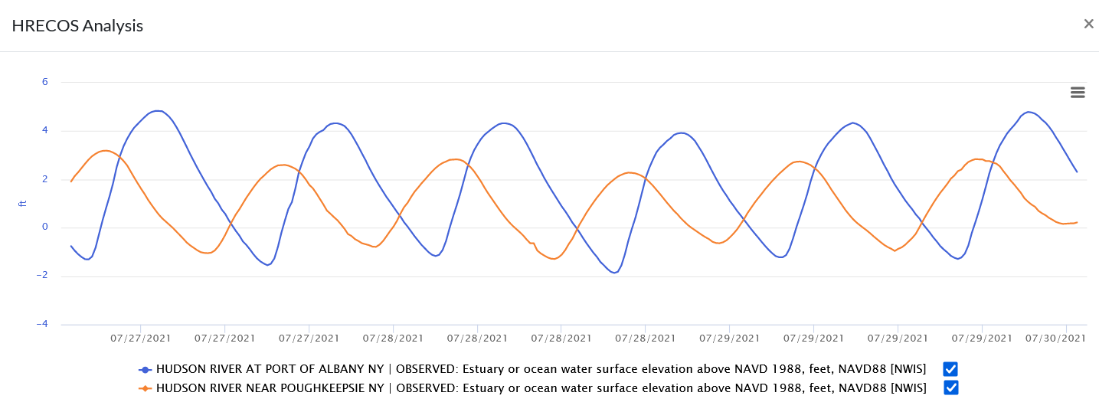
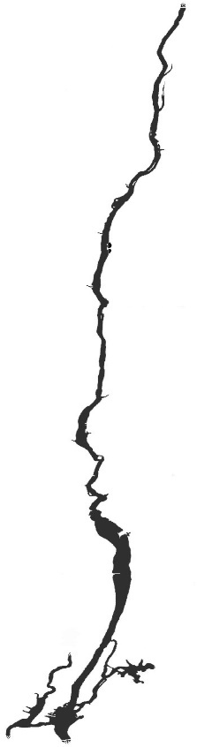
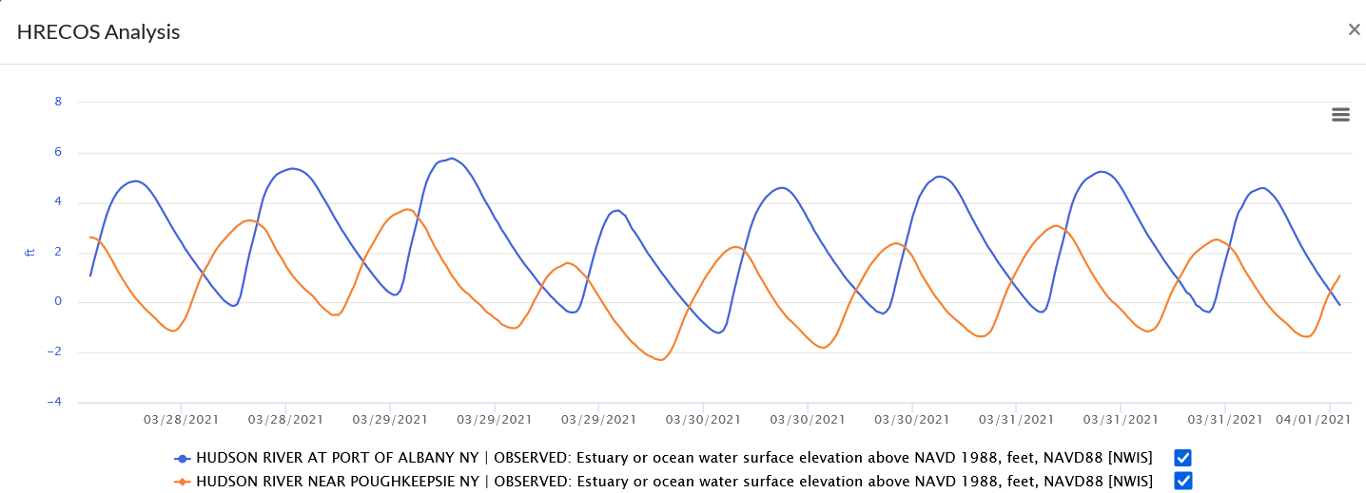
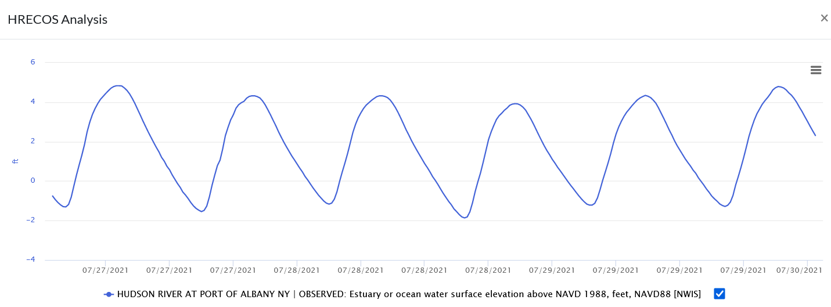
Case Study #3: Tides in the Hudson estuary
Tides travel all the way to Albany; the river’s surface is usually close to or at sea level there.
Albany
Poughkeepsie
It’s spring. Snow is melting and there’s lots of rain, raising river levels near Albany. By the time the water gets to Poughkeepsie, it’s dropped to sea level.
Tides are more extreme in Albany – highs higher, lows lower. A given high or low tide happens later in Albany than in Poughkeepsie.
Why is water elevation higher at Albany than at Poughkeepsie in this graph of tides in March 2021?
How do tides at Albany differ from tides at Poughkeepsie as shown in this graph of tides in July 2021?
Notes:
There are two high and two low tides on the Hudson estuary and New York harbor on most days. CLICK Generated in the ocean, tides roll up the Hudson past Albany to a dam at Troy, since the river’s surface is usually close to sea level all the way to that dam. CLICK. How are tides in Albany different from tides in Poughkeepsie? CLICK. A given tide occurs later in Albany than at Poughkeepsie, as it needs time to travel up the Hudson. Tides in Albany (and also in NY harbor) tend to be more extreme than tides in the mid-Hudson – highs are higher, lows lower. CLICK. Why are water elevations in this graph higher in Albany than they are in Poughkeepsie? The March dates are a possible clue. CLICK. It’s spring – snow is melting and there’s lots of rain. Runoff from the watershed raises river levels higher than sea level near Albany. Levels drop towards sea level further south at Poughkeepsie. Note: The tide peaks in Albany are not symmetrical; heavy runoff prolongs the falling tide as it pushes towards the sea.

Slide 16
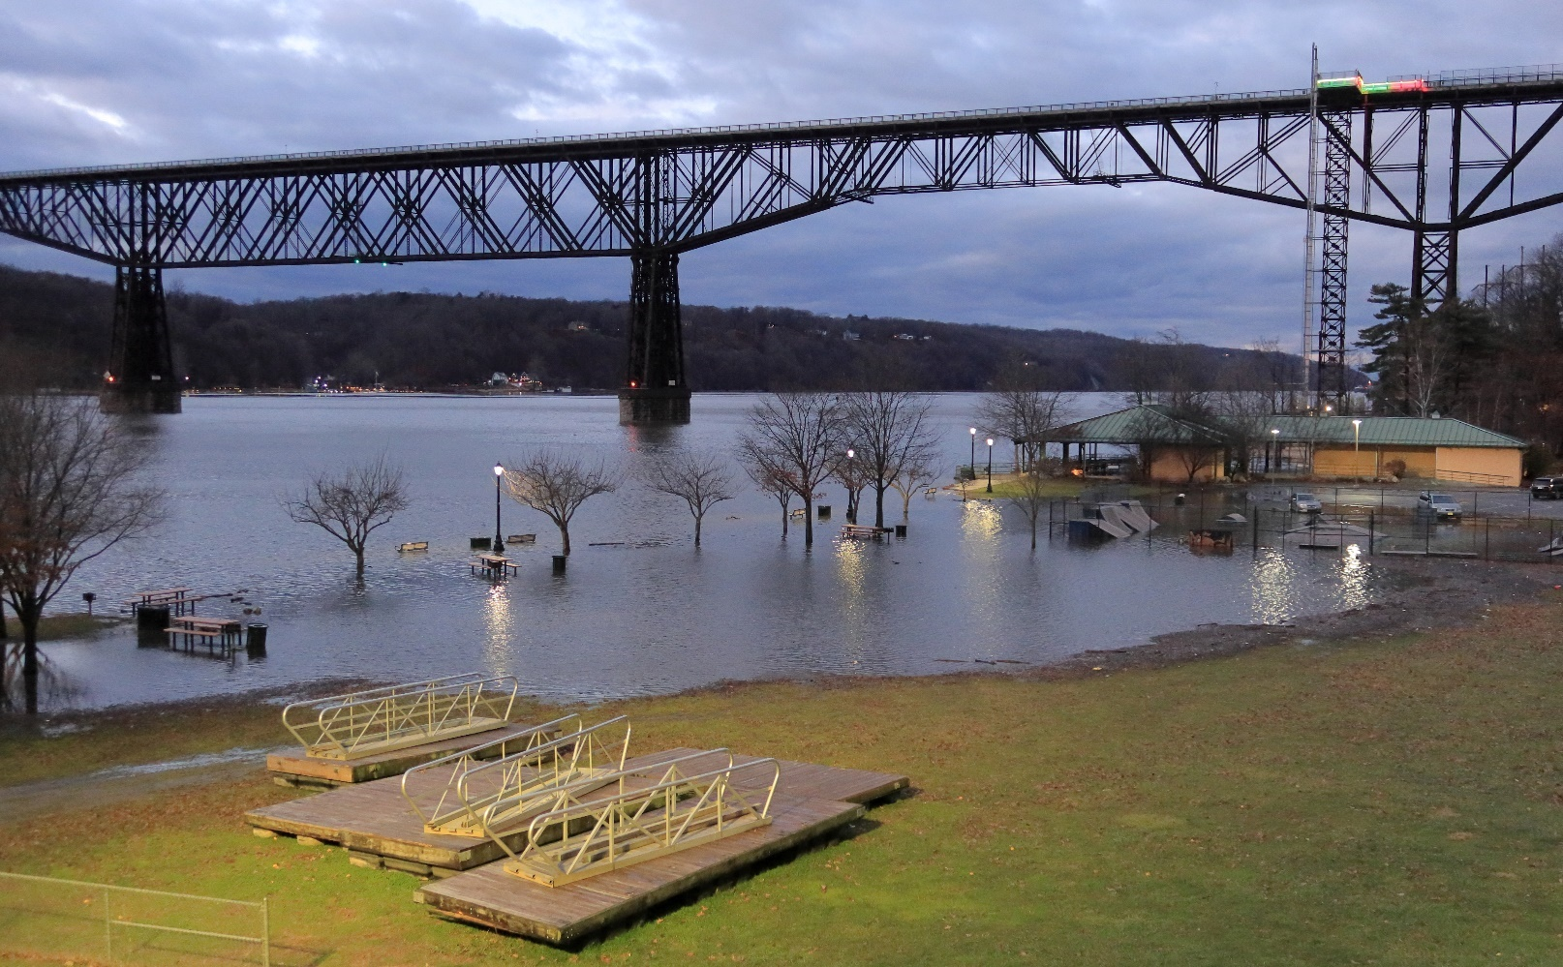
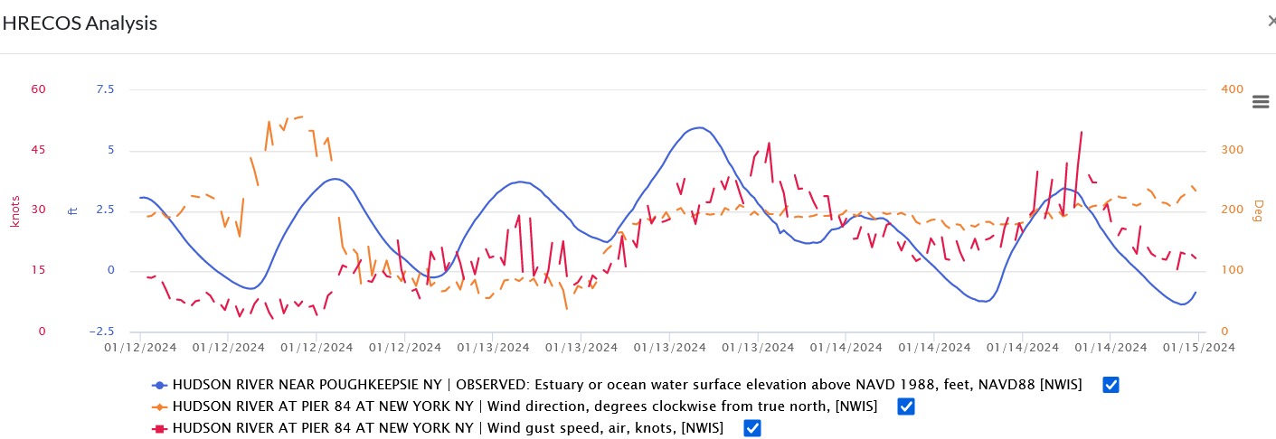
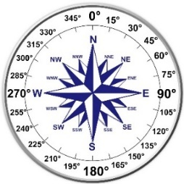
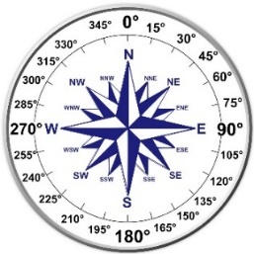
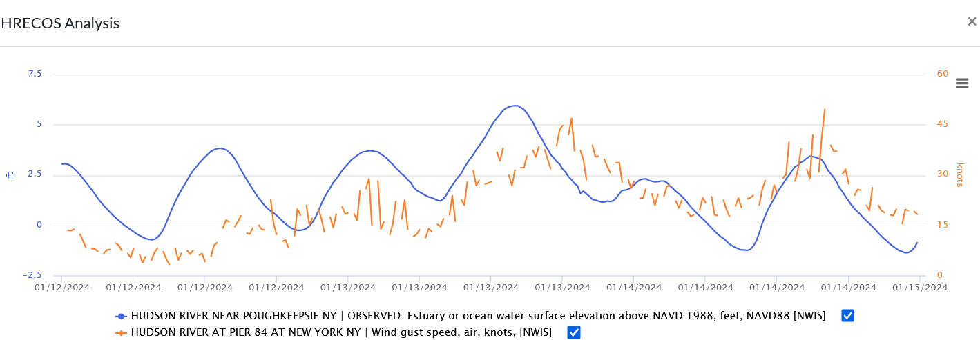
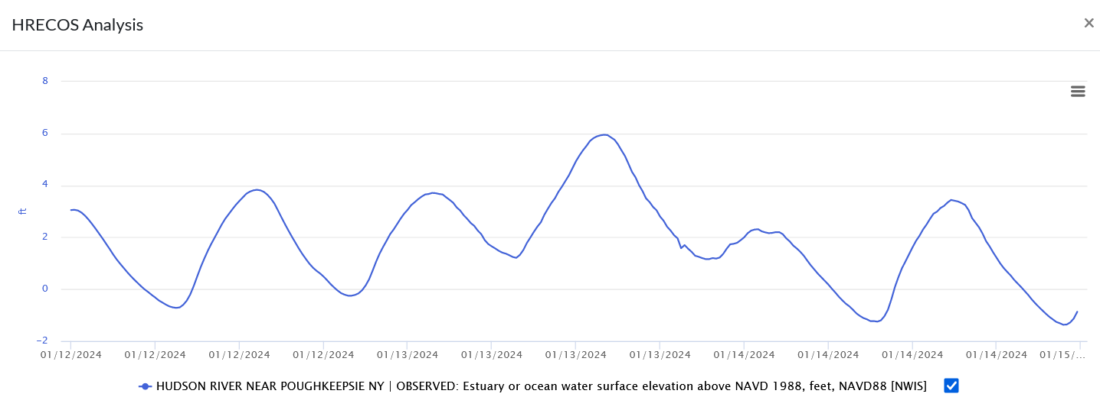
Case Study #4: Wind effects on water levels
Water levels pushed up by storm surge
Notes:
Strong, sustained winds associated with coastal storms such as nor’easters and hurricanes may impact water levels. Their winds can push water into the coast and up the Hudson – a phenomenon called storm surge. Storm surge shows as higher low and high tides on 1/13/24 in this graph of water elevation at Poughkeepsie during such a storm. CLICK to add a plot (orange) of wind gusts at Pier 84 in Manhattan (wind data isn’t available for Poughkeepsie, and the winds that caused this effect were strongest nearer the coast). Wind gusts started to grow stronger late on 1/12/24 and increased to about 45 knots (52 miles per hour) on 1/13/24. Wind direction plays an important role in storm surge. CLICK to add plot of wind direction in degrees from North. Note: the wind direction plot is orange, while the wind gust plot has changed to red. At about the same time that the wind started to blow harder at Pier 84 it switched direction from coming out the north (360º) to coming out of the east (90º). CLICK to bring up a compass rose and arrow indicating the easterly wind direction. As the wind strengthened on the 13th it also swung to come out of the south/southwest (~200º). CLICK to bring up another compass rose and arrow showing the wind shifting to the south. These winds pushed ocean water towards the coast and up the Hudson as storm surge, causing flooding at Poughkeepsie.

Slide 17
A Suggested Classroom Activity
Use the following slides with students to practice graph interpretation, formulate and test hypotheses, and explore HRECOS.
Divide the class into four groups. Give each a printout of one of the following graphs. Show slide [#18] Interpreting Graphs, and review the questions to be addressed. Allow ~10 minutes for groups to come up with answers. Then have each group present their answers and hypotheses to the class. If each has a computer, they can go ahead and test their hypotheses before presenting them to the rest of the class. This may require more time.
Bring up the HRECOS interface on the classroom screen. As each group starts, set the interface to display their graph. Then manipulate the interface as the group directs, selecting stations, parameters, and time periods to look for correlations with factors the group thinks are having an impact. Alternatively, use the screen shots that follow each graph in this show to point out correlations.

Slide 18
Interpreting graphs: What is the story that each of these graphs tells?
Working in small groups, answer these questions:
1. What is being measured in this graph?
2. Where is it being measured?
3. Over what time period is it being measured?
4. What happens to it over the time period shown?
5. What is your hypothesis about what caused this to happen?
6. Measurements of what other parameters would help you test and verify your hypothesis?
We will then go on the web and give each group a chance to test its hypothesis.

Slide 19
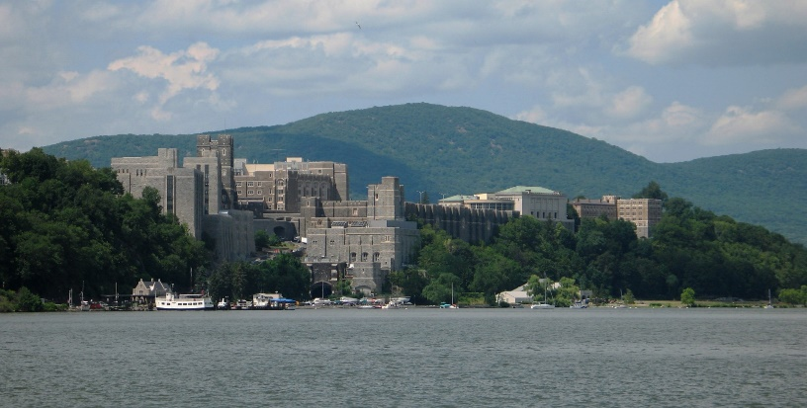
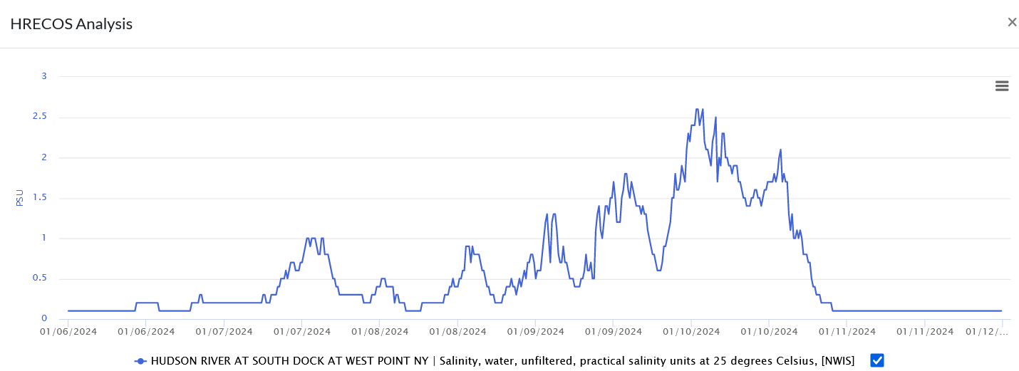
Group One
HRECOS Current Conditions page
Notes:
This graph displays salinity at West Point’s South Dock 1/6/24-1/11/24. Salinity was nearly zero until it started to creep up on 1/6/24. Salinity peaked 1/10/24, and then dropped steeply back down almost to zero. To display this graph on the HRECOS interface, select Hudson River at South Dock at West Point from the Station dropdown menu, select Salinity from the Hydrologic Parameter menu, click on Choose Specific Date Range, and set the Start Date as 2024-06-01 and the End Date as 2024-01-11. Then click on Show Graph.

Slide 20
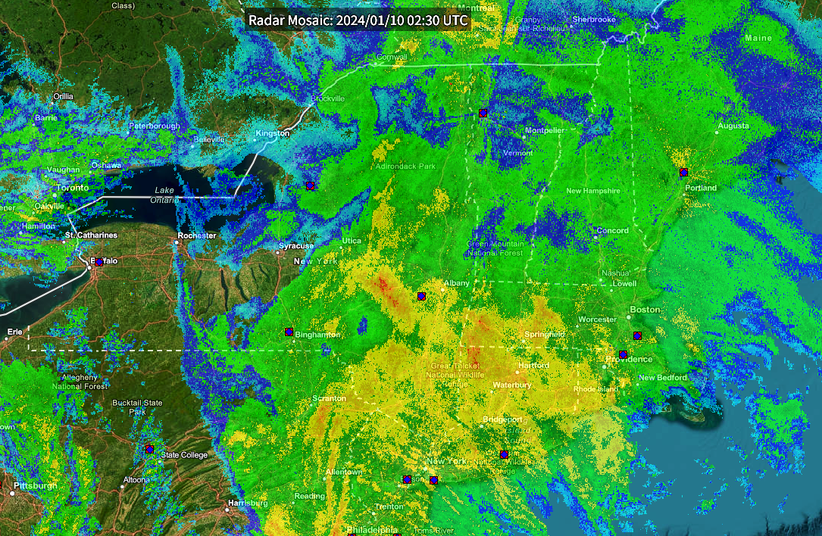

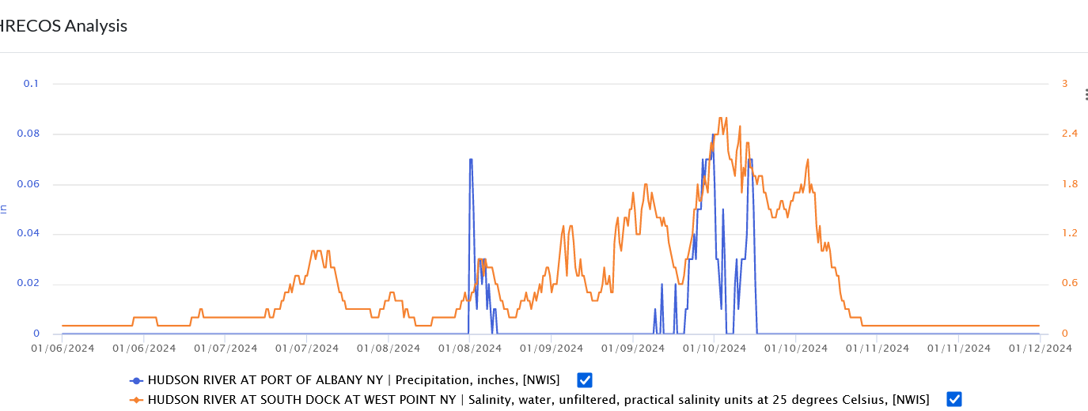
Group One
Albany
National Oceanic & Atmospheric Administration
Notes:
Rainfall (or lack of it) in the Hudson’s watershed is a likely cause of changes in salinity over days or weeks. The West Point station doesn’t measure rainfall; so another station that does must be selected. Albany is often a good choice, as it is close to the largest parts of the watershed where heavy rains can result in substantial runoff. To add Albany data to the graph of salinity at West Point, open the Station dropdown menu and add Hudson River at Port of Albany, select Precipitation in the Hydrologic Parameter menu, and click on Show Graph. CLICK The salinity plot changed color when the precipitation plot was added; it’s now orange, while precipitation is blue. There was a bit of precipitation on 1/8, but not enough runoff to hold the sea salt downriver. It moved north until a more intense precipitation event took place 1/9-1/10. CLICK This radar image shows the rainstorm impacting most of the Hudson’s watershed. The yellow and orange areas indicate especially heavy rain; such areas can be seen in the Mohawk Valley and Catskills. There was a lag as runoff took time to flow down tributaries and into the Hudson, but then salinity fell quickly to near zero. Note: There is another pattern here, a bit noisier and harder to see. As salinity rises above zero, two peaks and two dips in salinity occur each day, corresponding to the river’s tidal cycles. Salinity readings fall as the ebb current flows past the sensor towards the ocean; it rises as the river’s tidal current switches direction and a flood current pushes upriver past the sensor.

Slide 21


Group Two
HRECOS Current Conditions page
Notes:
This graph displays Water Surface Elevation at the Port of Albany 12/15/23-12/24/23. After rising and falling in a regular pattern (why?), water level begins to rise steeply on 12/18, stays high through 12/19, and then slowly drops back down to near normal on 9/23. To display this graph on the HRECOS interface, select Hudson River at Port of Albany, NY from the Station dropdown menu, select Elevation from the Hydrologic Parameter menu, click on Choose Specific Date Range, and set the Start Date as 2023-12-15 and the End Date as 2023-12-24. Then click on Show Graph.

Slide 22



Group Two
Albany
National Oceanic & Atmospheric Administration
Notes:
The graph shows the river rising and falling twice each day due to tides. On 12/18 the river rises steeply, peaking on 12/19. While dropping after that, water level stays higher than usual for several days. Possible causes are rainfall or storm surge. To add rainfall to the graph already displayed on the HRECOS interface, add Precipitation from the Meteorologic Parameter menu, then hit Show Graph. CLICK Note that the elevation plot changed color when the precipitation plot was added; it’s now orange, while precipitation is blue. There was lots of rainfall over the watershed on 12/18. It took some time for runoff to drain into the mainstem, hence the continuing high water levels at Albany in the days following the storm. CLICK The yellow and orange colors in this radar image show especially intense precipitation in the Hudson’ watershed when this image was captured that morning. Later the storm – a nor’easter – caused disastrous flooding to Vermont. BUT, did storm surge also have a role here? See the next slide.

Slide 23




Group Two
Notes:
A plot of storm surge typically shows water level rising sharply and then falling almost as steeply as the storm and its winds move on. Plots of flooding from heavy rains typically show an lengthier period of high water; that is visible in Albany, but the plot also shows water level starting up before the rains on 12/18, and the rise on the 18th is very fast. If surge did occur with this storm, if would have moved upriver from the Atlantic Ocean, so stations downriver would show a storm surge peak. Do they? Reset the graph to show only elevation at Albany. Then add Hudson River at Pier 84 at New York from the Select Station dropdown menu and CLICK on Show Graph. The orange plot of water level at Pier 84 does show a slight peak early on 12/18. It drops off quickly, suggesting some storm surge but no flooding from runoff. Now add Poughkeepsie from the Select Station dropdown menu. CLICK on Show Graph. Albany is still blue, Pier 84 is now red, and Poughkeepsie is orange. There is a storm surge peak in Poughkeepsie, and some flooding due to runoff as well. During flooding caused by runoff, the river equilibrates to sea level in its lower reaches. CLICK During this storm the City of Kingston - being located where a large tributary, the Rondout Creek, enters the Hudson – got a double whammy of flooding from storm surge and runoff.

Slide 24

Group Two
Albany
Monday, Dec 18, 20:30
Monday, Dec 18, 16:30
Monday, Dec 18, 12:30
Poughkeepsie
Pier 84
Notes:
A sidebar: Take a closer look at storm surge progress up the Hudson. Plot the upriver progress of the high tide augmented by storm surge on 12/18. To make this graph, continue to include Albany, Poughkeepsie as selected stations and Elevation as the Hydrologic Parameter, but reset the Start and End Dates as 2023-12-18 and 2023-12-19, then click on Show Graph. Using your cursor, left click on the graph to outline a box that extends from 0800 12/18 to 0100 12/19 horizontally and -2.5 feet to 10 feet vertically. Release the cursor button; in a second or two the graph will be zoomed in to the area within the box. At this zoom level, the sensor readings – taken every 15 minutes – show as individual dots. Hovering the cursor over any of these dots will bring up a popup window showing the time and the water elevations for all three sites. CLICK The text in the popups is too small to be easily read on a classroom screen, so CLICK 3x in succession to bring up text boxes indicating the time at which the surge-driven high tide reaches each station. It takes about four hours for this peak to move from Pier 84 to Poughkeepsie, and another four for it to reach Albany.

Slide 25


Group Three
HRECOS Current Conditions page
Notes:
Readings from remote-sensing stations are greatly influenced by the local environment surrounding each one. Piermont is a good example. The sensors are located at the end of a pier that extends a mile out into the Tappan Zee. The Tappan Zee is very broad – nearly three miles wide – and very shallow. While the water at the end of the pier is over 15 feet deep, only a few feet of water cover the mudflats alongside most of the pier. With that environment in mind, CLICK think about various factors that might have caused the turbidity peak shown here. To display this graph on the HRECOS interface, select Hudson River at Piermont, NY from the Station dropdown menu, select Turbidity from the Hydrologic Parameter menu, click on Choose Specific Date Range, set the Start Date as 2016-01-03 and the End Date as 2016-01-06. Then click on Show Graph.

Slide 26




Group Three
Notes:
Rainfall is a good place to start when looking at turbidity peaks. Keeping the station, turbidity, and date selections the same as on the existing graph, add Precipitation from the Hydrologic Parameter menu and then CLICK on Show Graph. There was no precipitation before or during this time period. What else might stir up the water and create muddy conditions, especially where the water is not very deep? What about wind? In the dropdown menu in the Select Meteorologic Parameter box remove Precipitation and add Wind Speed, then CLICK on Show Graph. Strong winds occurred at the same time as the peek in turbidity. These winds kicked up waves on the wide and shallow Tappan Zee, CLICK stirring up the water down to the river bottom and suspending mud – making the river more turbid.

Slide 27


Group Four
HRECOS Current Conditions page
Notes:
This graph displays dissolved oxygen concentration in the Hudson near Poughkeepsie from 7/13/23-7/24/23. To display this graph on the HRECOS interface, select Hudson River Near Poughkeepsie in the Station dropdown menu and dissolved oxygen in the Hydrologic Parameter menu. Click on Choose Specific Date Range and set the Start Date as 2023-07-13 and the End Date as 2023-07-23. Click on Show Graph.

Slide 28



Group Four
Notes:
After rising and falling 7/3 to 7/16, DO concentrations drop sharply on 7/17. They stay at a lower level through 7/23 and the rising and falling pattern of the previous days is less extreme. What causes the rising and falling pattern over the first few days? This is the typical 24 cycle of increasing DO levels due to photosynthesis during daylight and falling DO levels as photosynthesis ceases and respiration continues at night. Unfortunately, sunlight data – photosynthetically active radiation – were not available at any other site during this time period.
What causes the drop in DO on 7/17? Increasing turbidity would block sunlight necessary for photosynthesis. Warming water temperatures might reduce DO levels. To add turbidity to the graph, select it in the Select Parameter dropdown menu and click on Show Graph. CLICK Turbidity increases throughout the period and remains elevated through 7/24. By blocking sunlight it reduces both DO levels and the swing in its concentration between day and night. To add temperature to the graph, select water temperature from the Select Parameter dropdown menu and click on Show Graph. CLICK (Note: To make the graph clearer, the turbidity plot has been removed by clicking the check box at the end of that parameter title.) The water gets cooler after 7/17, which should allow DO concentrations to rise. Instead they fall. Turbidity is the culprit here.

Slide 29


Group Four
Notes:
If students haven’t already brought this up, ask what might have caused turbidity to rise over this period. A likely cause is precipitation that causes flooding and erosion in tributaries, which then carry the eroded sediment into the Hudson. Precipitation is not recorded at the Poughkeepsie station, so another station must be selected. Add Norrie Point Meteorological (NERRS) to the graph of turbidity at Poughkeepsie by choosing it from the Station dropdown menu. Select Precipitation in the Hydrologic Parameter menu, then click on Show Graph CLICK. Over 1.3 inches of rain fell at Norrie Point on 7/16. Note: At sites upriver and closer to tributary mouths (Albany and Schodack Landing), increasing turbidity can sometimes be accompanied by an increase in dissolved oxygen as floodwaters promote mixing of atmospheric oxygen into the water. However, the 24 hour cycle of DO concentration is usually suppressed by the turbidity.

Slide 30

Other remote sensing stations
The Battery, Manhattan (NOAA)
Notes:
The National Oceanic and Atmospheric Administration’s tide gauge at the Battery compares actual water levels (in red) to predicted levels (in blue), the latter based on the astronomical forces that govern tides. This plot shows water levels from 11/21/23 to 11/23/23. (The station also records data for Water and Air Temperature and Air Pressure; see Station Home Page.) Placing the cursor on the plot allows one to see and compare the predicted water level with the actual level. At 07:42 GMT – 2:42 PM – water levels were more than 2.7 feet higher than expected, the result of surge from a coastal storm. If desired, click on the hyperlink in the title to go to the Battery homepage, then on Tides/Water Levels; in the dropdown menu, click on Water Levels to access data. The default time zone is Greenwich Mean Time (GMT) and the default datum is Mean Lower Low Water (MLLW). In the Options area below the graph, use the dropdown menu arrows to select Local Standard Time/Local Daylight Time (LST/LDT) and – if desired – to change the datum. To change the date range and examine historical data use the From and To buttons to select a date range up to 31 days long. Then click Plot to update the graph. Note that the red plot of actual water level is labeled preliminary; at the time this graph was copied into this presentation the data had not yet been verified by a person.

Slide 31

Other remote sensing stations
Turkey Point, Hudson River, Ulster County (NOAA)
Notes:
NOAA’s gauge at Turkey Point on the Hudson started operation in June 2017. Like the Battery gauge, it compares actual water levels to predicted levels. (The station also records data for Water and Air Temperature, Air Pressure, Relative Humidity, and Wind Speed/Gusts; see Station Home Page.) If desired, click on the hyperlink in the title to go to the Turkey Point homepage, then on Tides/Water Levels; in the resulting dropdown menu, click on Water Levels to access the page shown here, which has data for the same event captured in the previous slide. The default time is Greenwich Mean Time (GMT) and the default datum is Mean Lower Low Water (MLLW). In the Options area below the graph, use the dropdown menu arrows to select Local Standard Time/Local Daylight Time (LST/LDT) and – if desired – to change the datum. Use the From and To buttons to select a date range up to 31 days long, going back to June 2017. Then click Plot to update the graph.

Slide 32



Other remote sensing stations
National Data Buoy 44065 (NOAA)
Conditions at sea - strong winds, for example – may impact water levels in the estuary.
Notes:
Use data from NOAA’s data buoy 44065 to observe conditions just off the coast of New York and New Jersey. CLICK to see a graph of wind conditions at the buoy during Hurricane Sandy as an example. If desired, click on the hyperlink in the title to go to the Buoy 44065 homepage and scroll down to access the data. Click on the graph icon by a parameter to see a data plot. Note that downloading historical data from this site takes a bit of expertise; it’s best to right click on graphs of interest as an event is happening (or soon thereafter) and save them to your hard drive.

Slide 33
Thank You!
For more information, please contact:
NYSDEC – Hudson River Estuary Program
21 South Putt Corners Road
New Paltz, NY 12561
845 256-3016
hrep@dec.ny.gov
Connect with us:
Facebook: www.facebook.com/NYSDEC
Twitter: twitter.com/NYSDEC
Flickr: www.flickr.com/photos/nysdec
Credits:
Produced in cooperation with the New England Interstate Water Pollution Control Commission & Hudson River National Estuarine Research Reserve.
PowerPoint created by Steve Stanne.
Unless otherwise credited, all photographs are by Steve Stanne.
Notes:
Contact information and credits.

Slide 34


Appendix Slide 1
Click here to enlarge map
Link to detailed HRECOS site map
Notes:
To view a more detailed map of the HRECOS system, click on the HRECOS site map link when showing the PowerPoint (link will not work in Edit mode). Then click on the full page icon in the upper right hand corner of the small map. Once in full page mode, enlarge and move the map around as needed.
ENLARGING AND MOVING MAP AROUND IS FLUKY!

Slide 35




Appendix Slide 2
Select site in Station dropdown menu or
Click on Station icon
Click on Site ID #
Links to detailed US Geological Survey station data & metadata
Notes:
Details about stations, the data recorded, the time periods for which data is available, and other information can be viewed on the U.S. Geological Survey’s Water Data for the Nation website. Clicking on a site icon on the HRECOS interface brings up identifying information for that site CLICK. Clicking on the site ID number goes to the USGS website CLICK and loads a legacy real-time page – an older version - for the station. Wait a few seconds for the current page to load automatically. One can bring up individual graphs for any of the parameters measured at the station. Scroll down CLICK for a table listing those parameters and the time periods during which data for each are available. Use the table to select the desired parameter(s) to graph.

Slide 36








Appendix Slide 3
Select site in Station dropdown menu or
Click on Station icon
Click on Partner link
Links to National Estuarine Research Reserve detailed station data & metadata
Notes:
Data from some of the stations in the HRECOS network are collected and posted by the National Estuarine Research Reserve System (NERRS). Details about those stations, the data recorded, the time periods for which data is available, and other information can be viewed on the NERRS Centralized Data Management Office (CDMO) website. Clicking on a NERRS site icon on the HRECOS interface brings up identifying information for that site CLICK. Clicking on the site partner link goes to the CDMO website CLICK. Move the cursor over the View/Download Data map and click CLICK. Scroll down to the Data Graphing and Export System option and click on Launch CLICK. On the map of Research Reserve sites, click on Hudson River, NY. CLICK Scroll through the list of stations and click on the choice desired to open a popup window. Hit the Click to Select button in the window. CLICK On the Choose Data page click on the graph icon. CLICK 2X The interface that appears allows one to choose from the Hudson River stations, select parameter(s), and specify a time period. In this example selections were made to compare dissolved oxygen levels with total photosynthetic radiation in early August 2023. CLICK to see graph.

