Slide 1
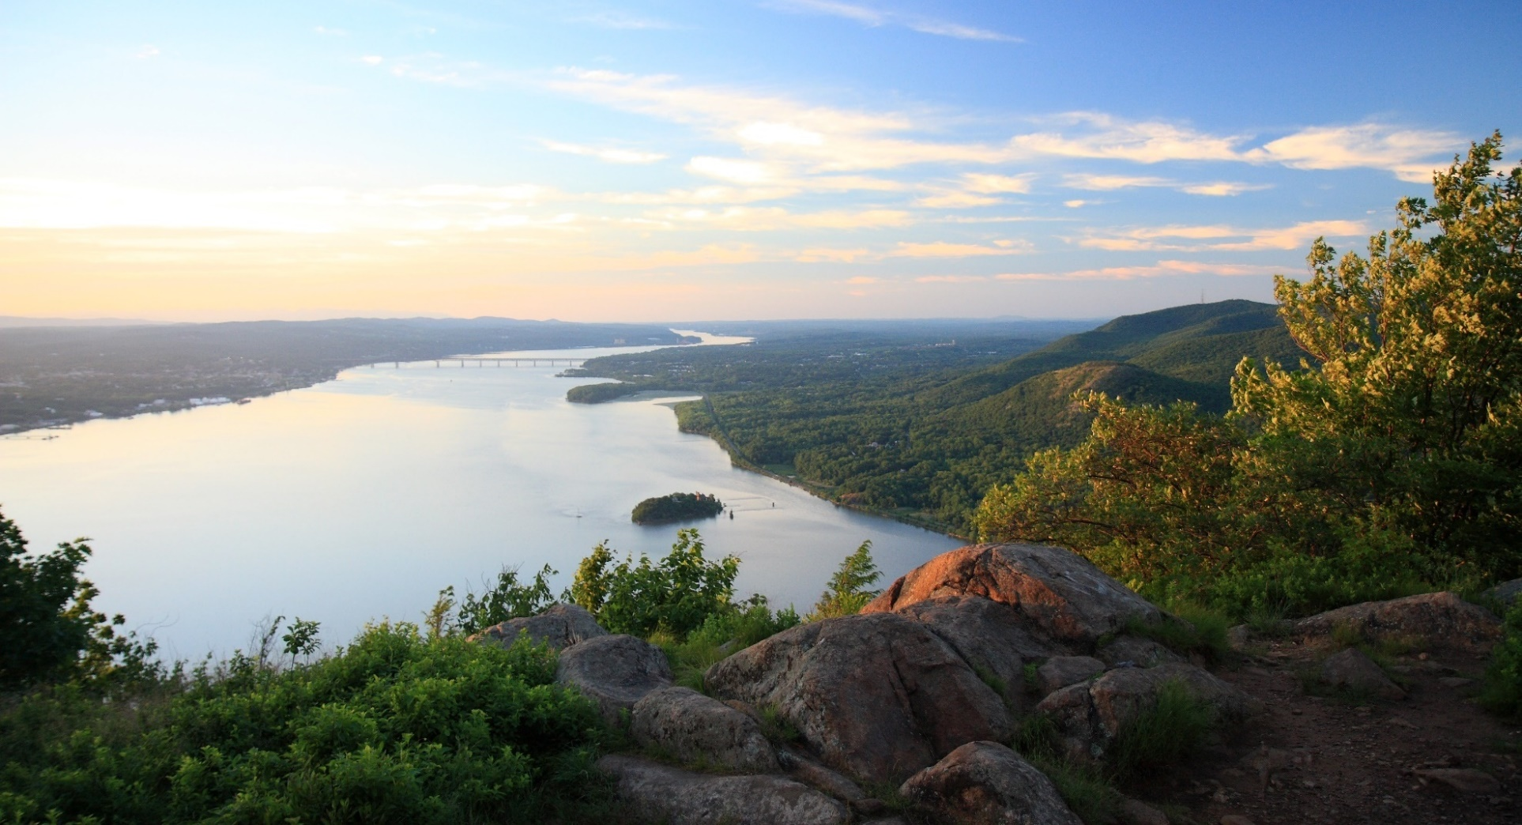
Wading into the Hudson…Virtually.
Hudson River Estuary Program
Notes:
Title slide.

Slide 2
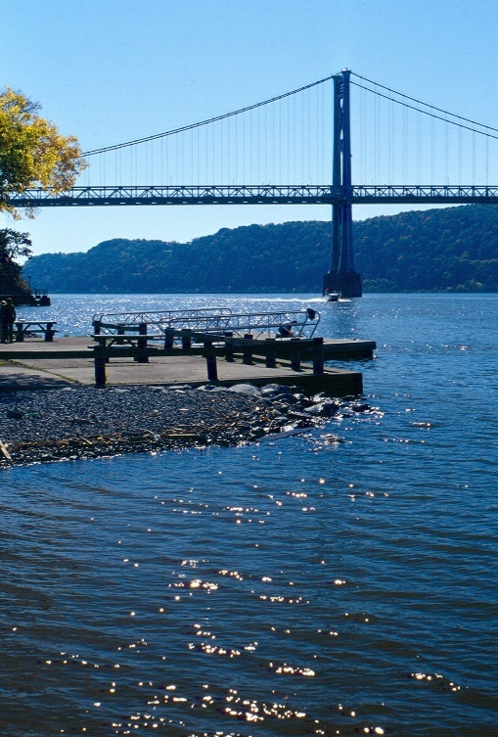
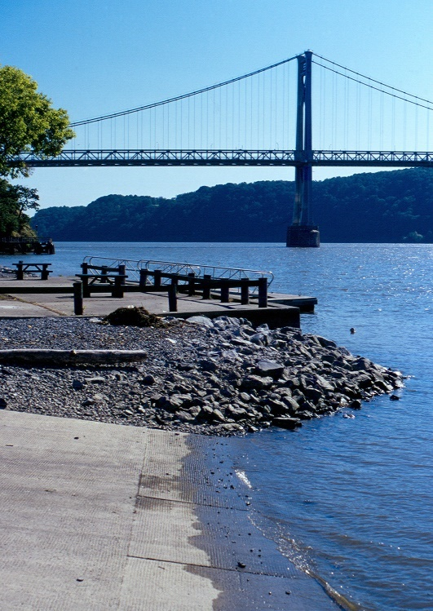
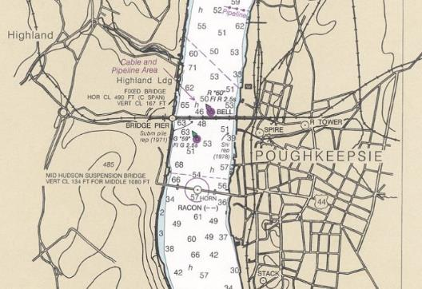
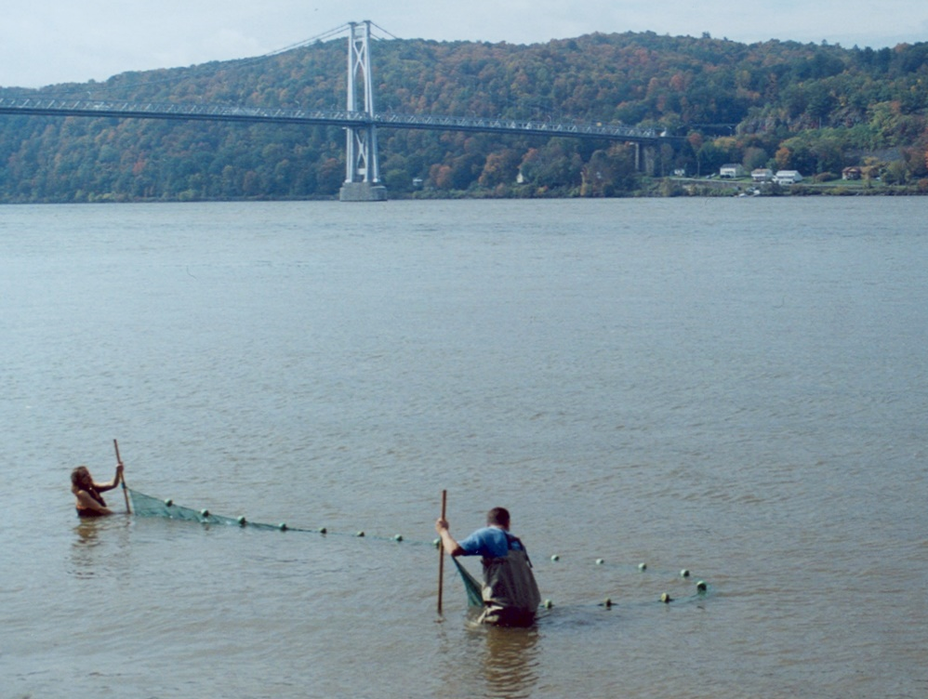
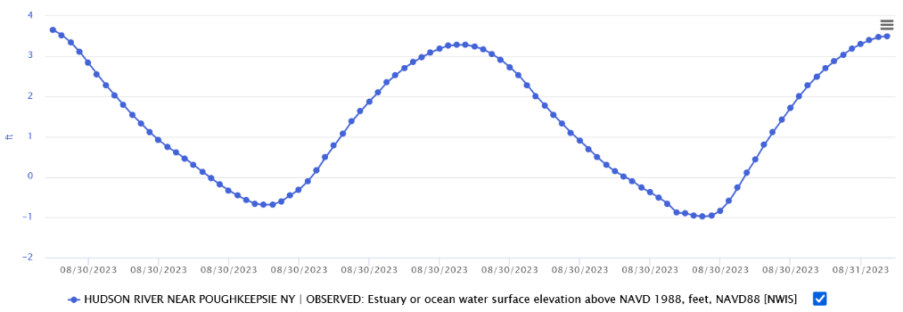
There are many ways to explore the Hudson River:
with photographs,
maps,
graphs,
and by wading in.
Notes:
Introductory slide. CLICK 4X IN SUCCESSION to show following images, all depicting the Hudson at Poughkeepsie: pair of photos showing high & low tide; nautical chart showing depths; graph showing high & low tides; photo of seining. Phenomena shown will be covered later in the PowerPoint.

Slide 3
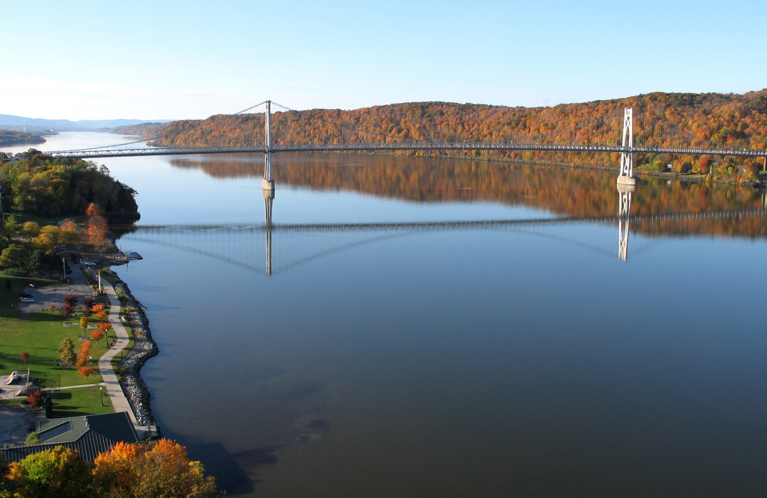
This show uses photographs, maps, and graphs.
in photographs…
on maps…
with graphs…
…and by wading in.
Notes:
CLICK ONCE to replace multiple images with single photograph of Mid-Hudson Bridge at Poughkeepsie.

Slide 4
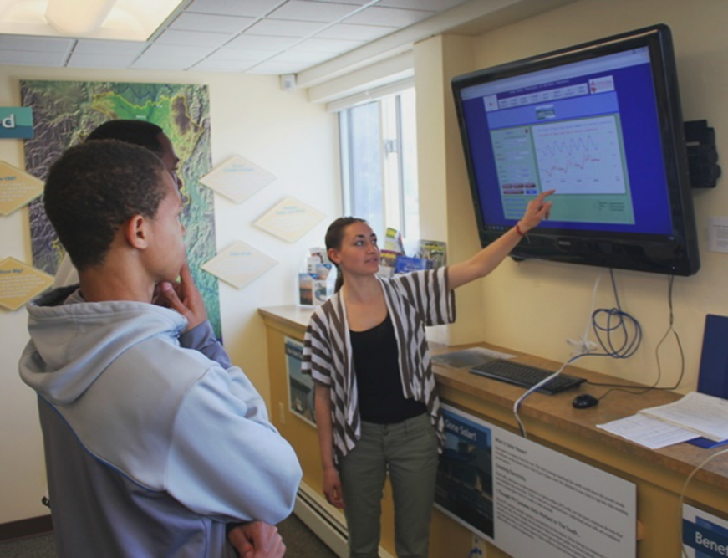
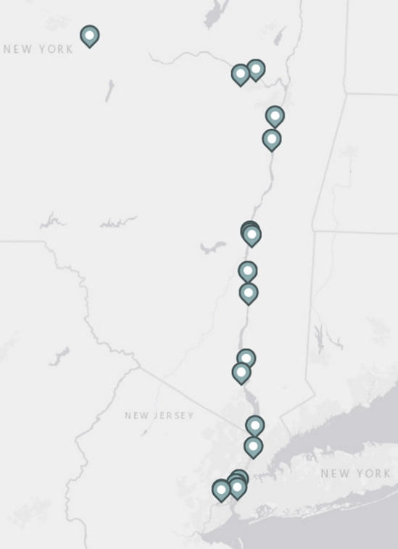
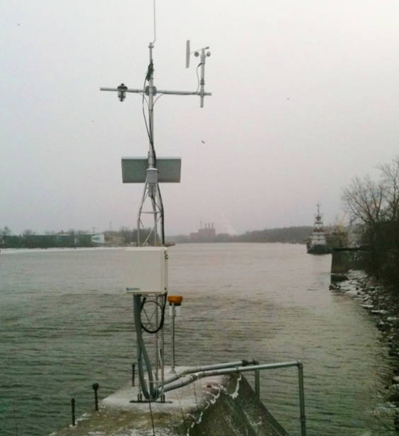
Will we wade in? No, but there are sensors out in the Hudson to report what is going on there.
Hudson River Environmental Conditions Observing System
(HRECOS)
Let’s start with some basics.
NYSDEC
Data from these instruments are posted on the internet for anyone to see.
Notes:
Photo of Hudson River Environmental Conditions Observing System (HRECOS) sensor installation at Port of Albany; map showing location of HRECOS sensor installations.
CLICK to show photograph of students viewing HRECOS data on monitor.

Slide 5
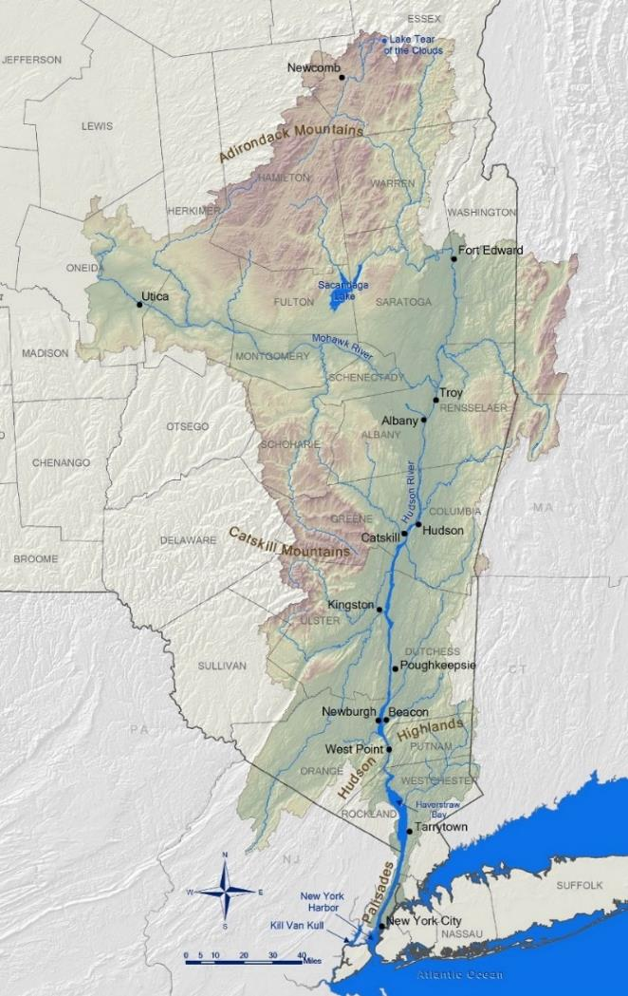
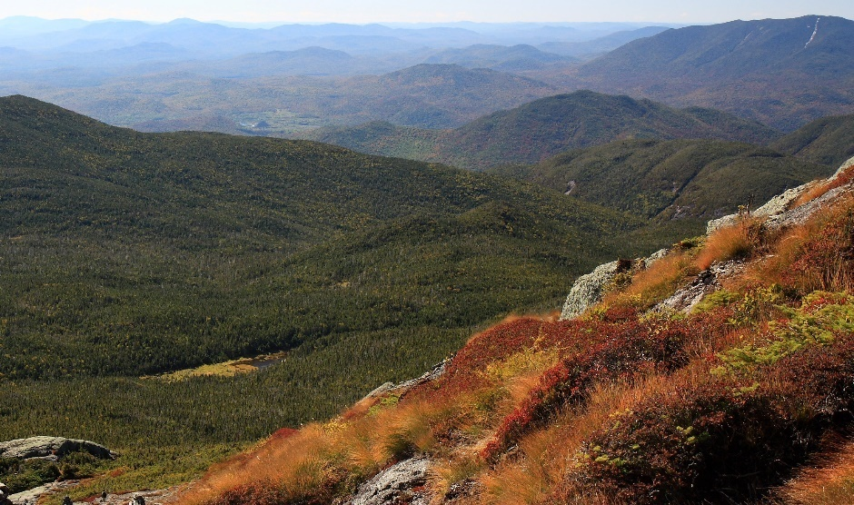
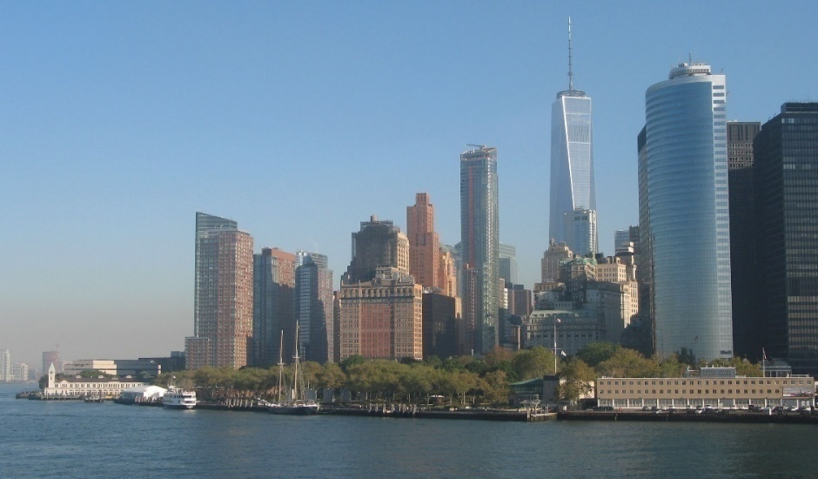
The Hudson’s course
315 miles as the river runs
Map by Hudson River Estuary Program/NYSDEC
Notes:
The Hudson’s course. Map shows the Hudson’s watershed. CLICK to show arrow pointing to Lake Tear of the Clouds with accompanying photo, followed by arrow pointing to the Battery at Manhattan’s southern tip, where the Hudson meets the Upper Bay of New York Harbor, with accompanying photo.

Slide 6
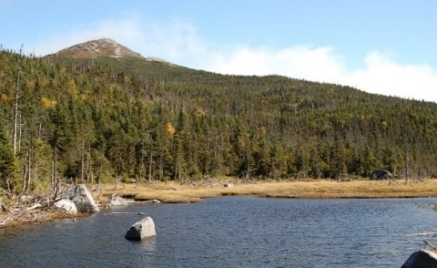
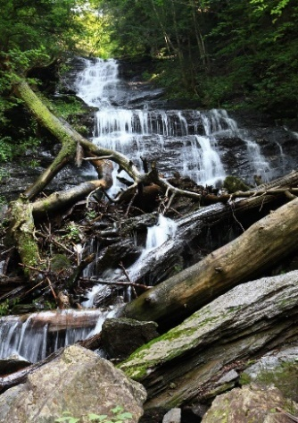
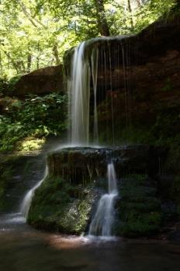

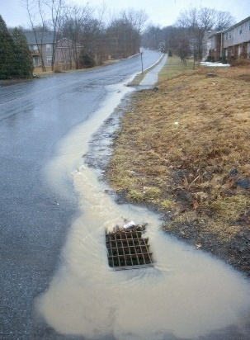
Lake Tear of the Clouds:
the source of the Hudson
Or is it ...
Kim Cuppett
(a) Money Brook on Mt. Greylock?
(b) the West Kill in the Catskills?
(c) runoff into a storm drain in New Paltz?
(d) All of the above
(d) All of the above?
The Hudson’s Watershed
Water flowing from any point within the watershed will head towards the Hudson.
Notes:
Photo of Lake Tear of the Clouds, accompanied by red star showing its location on the watershed map. “Or is it…” raises question of where the source of the Hudson really is – where does its water come from. CLICK to show photo of Money Brook and star indicating its location; CLICK to show photo of West Kill and star indicating its location; CLICK to show runoff in New Paltz and star indicating its location; CLICK to show question “All of the above?” CLICK to bring up definition of watershed, which implies that all of the above are sources of the Hudson.

Slide 7
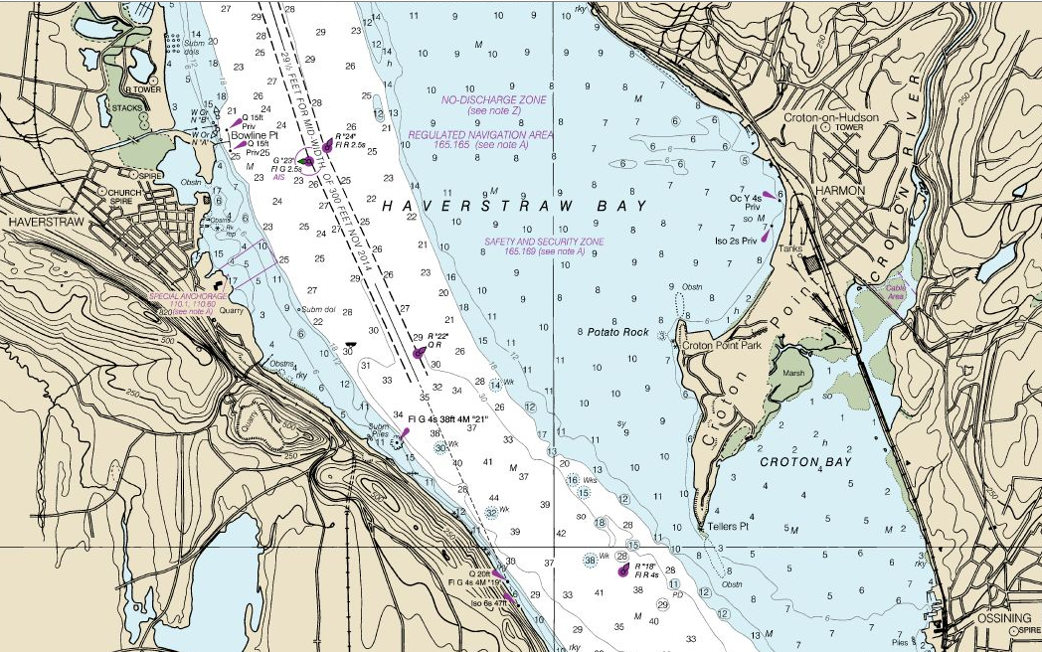
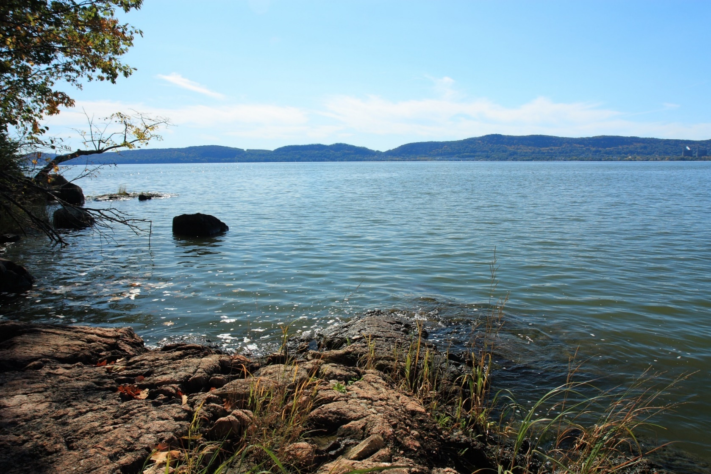
How wide?
~ 3.5 miles
Notes:
Photo of Haverstraw Bay, the widest part of the Hudson. CLICK to show nautical chart of Haverstraw Bay. CLICK again to show arrow indicating width east to west: 3.5 miles.

Slide 8
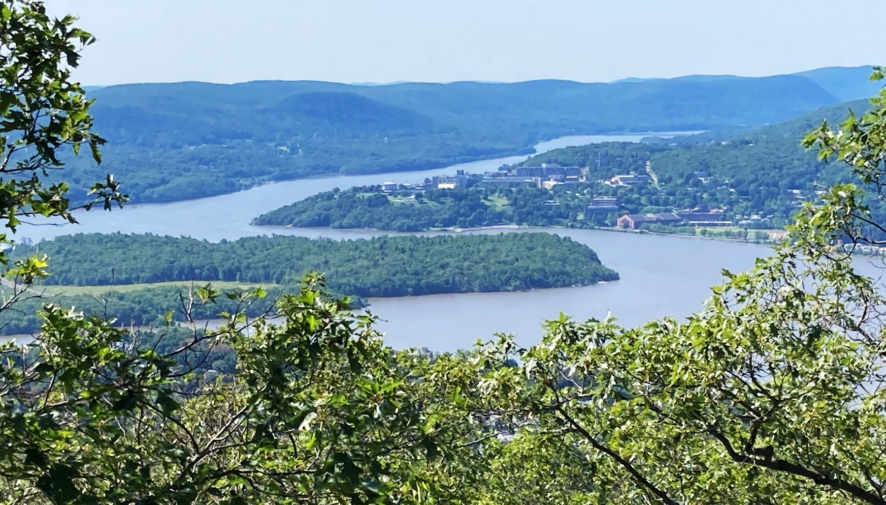
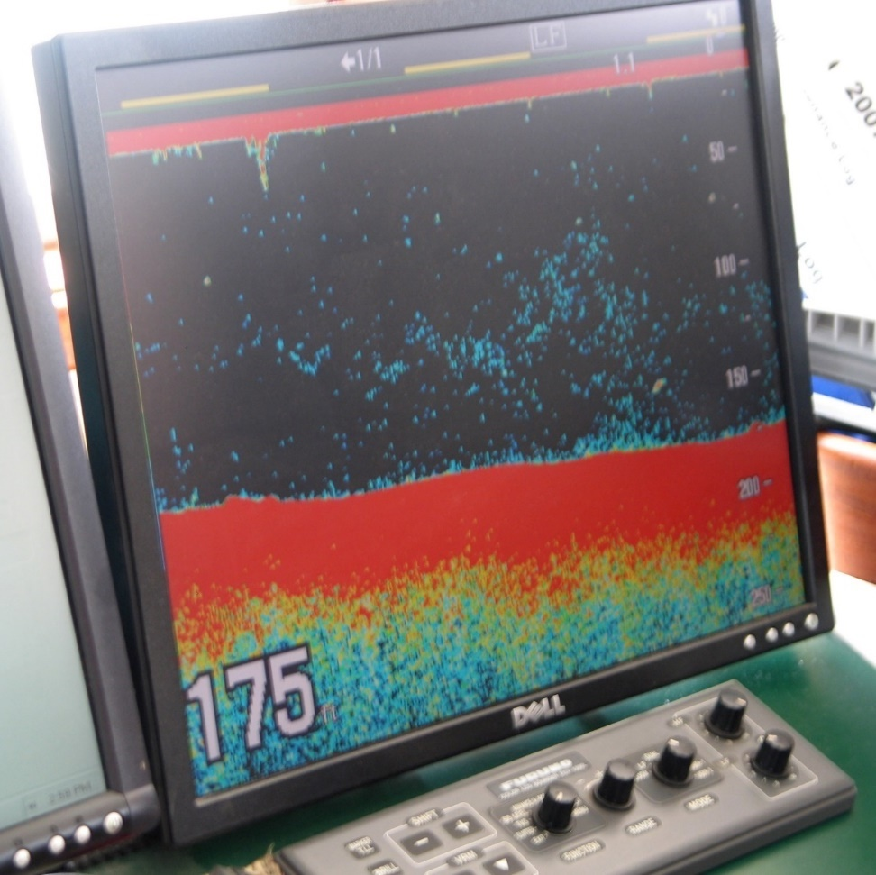
How deep?
Notes:
How deep? CLICK to show photo of Hudson at West Point. CLICK again to show photo of depth finder displaying a depth of 175 feet and an arrow indicating where that depth was recorded.

Slide 9
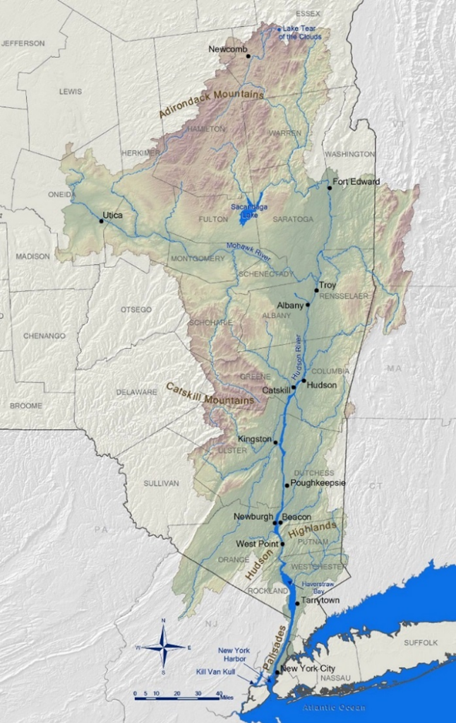


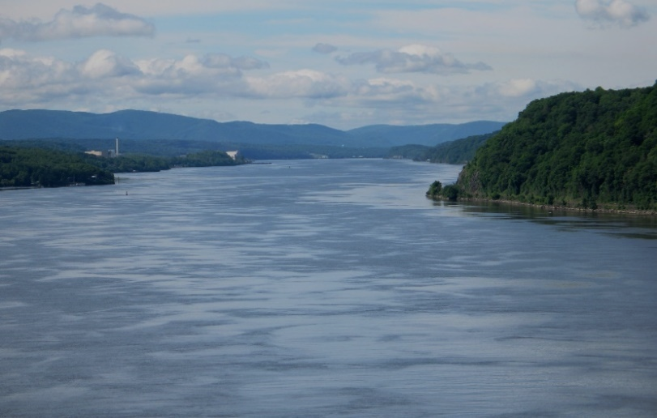
A Tale of
Two Rivers
River
River & Estuary
Notes:
A Tale of Two Rivers. CLICK to enlarge northern portion of watershed map, bring up arrow from Lake Tear of the Clouds to the Albany/Troy area, and show photo of whitewater rafting on the Hudson in the Adirondacks. In this section the river is fresh and flows in one direction, downhill towards the sea. CLICK again to reset watershed map. CLICK once more to enlarge southern portion of watershed map, bring up arrow from the Battery to Albany/Troy, and show photo of estuarine portion of the Hudson at Poughkeepsie. The term “estuary” will be defined in the next slide.

Slide 10
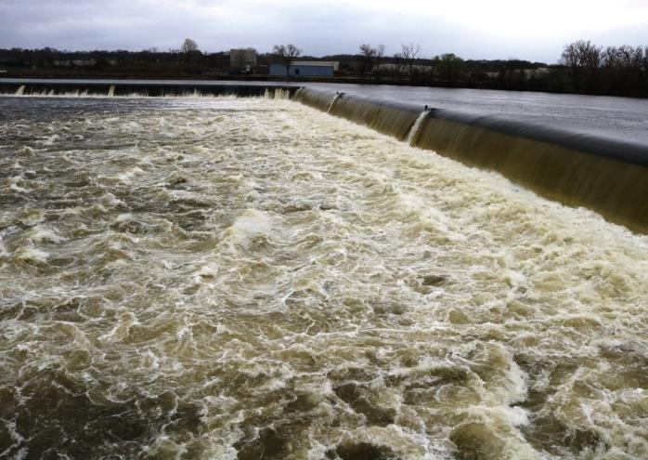
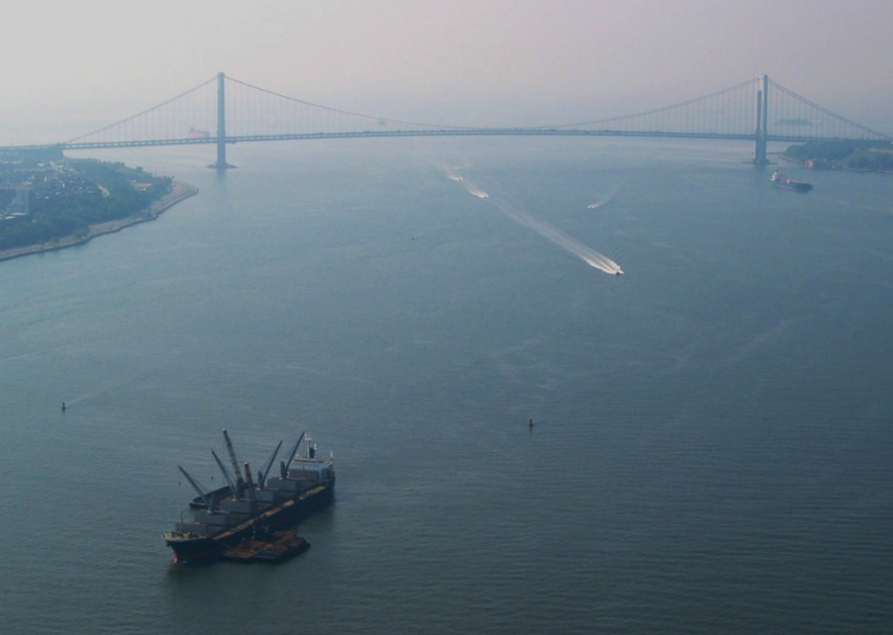
The influence of the Atlantic Ocean makes the lower Hudson an arm of the sea: an estuary.
Chris Bowser
Fresh water enters the estuary over the Troy Dam.
Salt water & ocean tides enter the estuary under the Verrazano-Narrows Bridge.
Notes:
Photo shows dam at Troy, over which fresh water drops nearly to sea level in the estuarine portion of the Hudson. CLICK to show the Narrows and the Verrazano-Narrows Bridge between the Upper and Lower Bays of New York Harbor, the main entry point for sea water coming into the Hudson estuary. Estuaries are usually defined as bodies of water, partially enclosed by land, in which fresh & salt water meet. However, salt water rarely intrudes beyond Poughkeepsie; the Hudson is not brackish all the way to Troy. Ocean tides do reach Troy, hence the Hudson is considered to be an estuary to that point.

Slide 11
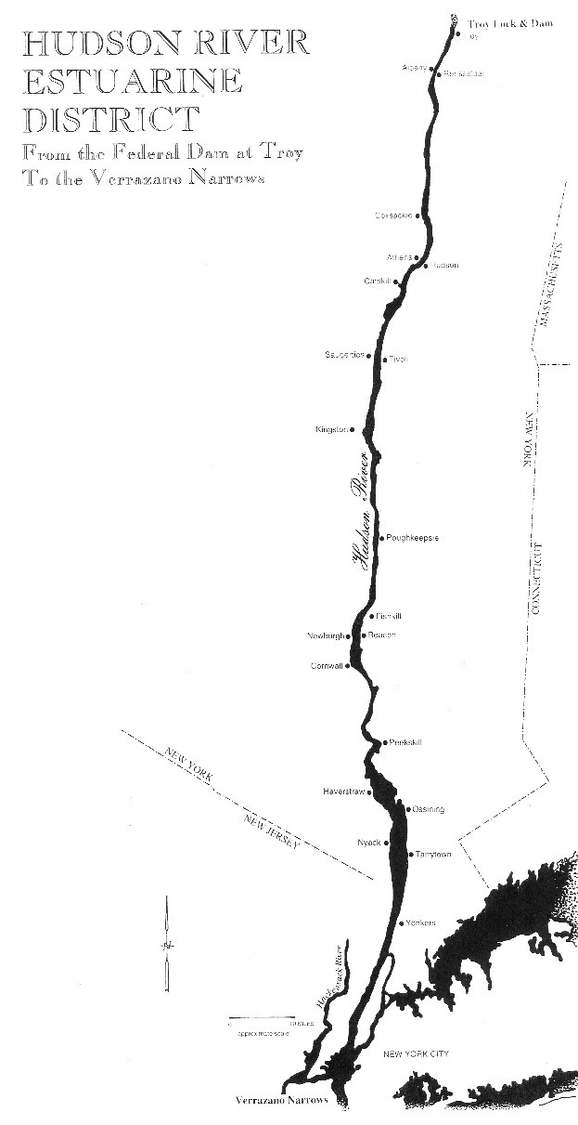
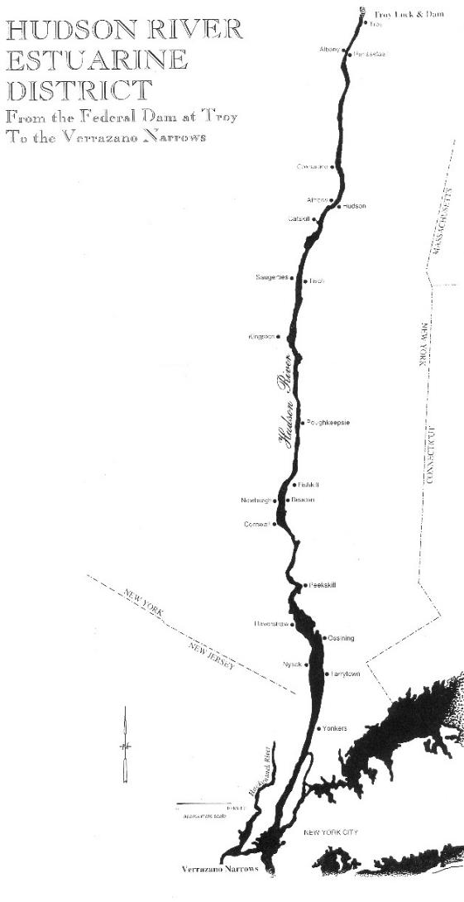
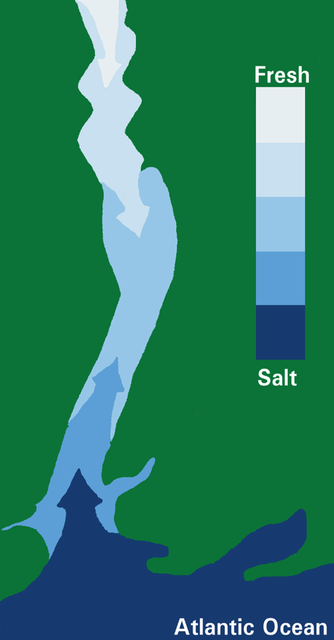
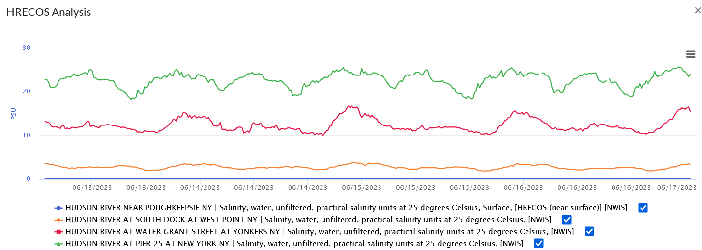
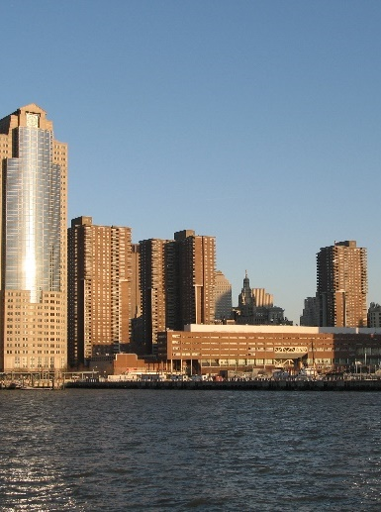
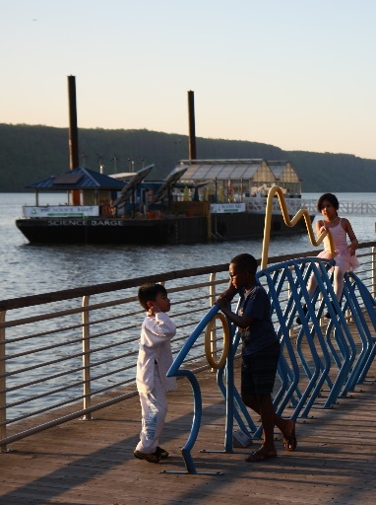
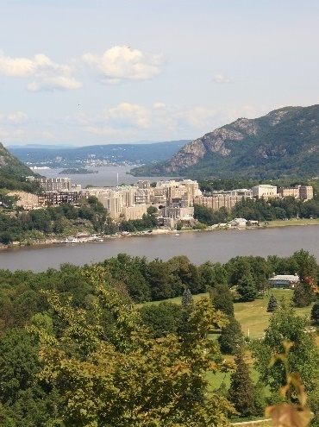
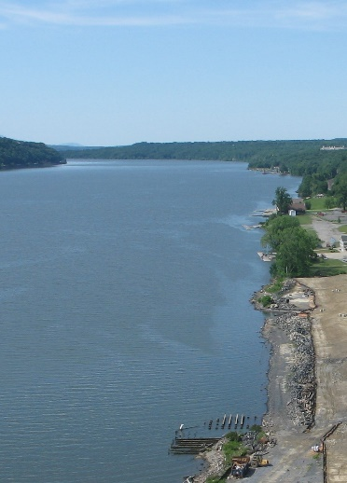
Notes:
Diagram of estuary showing mingling of fresh and salt water. CLICK to show map of Hudson River Estuarine District extending from the Federal Dam at Troy to the Verrazano Narrows Bridge. CLICK to show HRECOS graph with plots of salinity at four locations – New York City, Yonkers, West Point, and Poughkeepsie – from 6/13/23 to 6/17/23. (PSU - practical salinity units – are equivalent to PPT - parts per thousand – for our purposes.) Salinity decreases going up the river from New York Harbor. The point is emphasized with the next few clicks. CLICK to again show map of estuarine district. CLICK to show photo of Pier 25 in Manhattan accompanied by a green star indicating its position on the map. CLICK again to show Yonkers waterfront (the sensors are on the Science Barge) and an accompanying red star indicating its location on the map. CLICK once more to show West Point and an accompanying orange star indicating its location on the map. Finally, CLICK to show Poughkeepsie and an accompanying blue star. For reference, salinity in the open Atlantic Ocean off of New York is about 35 PSU.

Slide 12
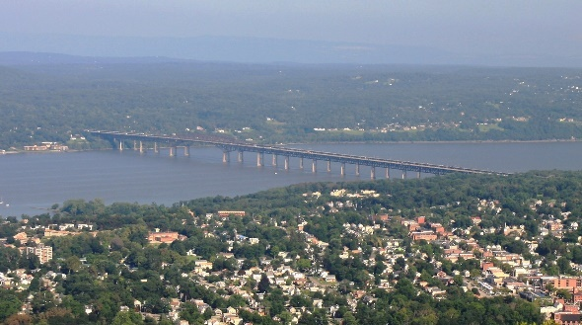
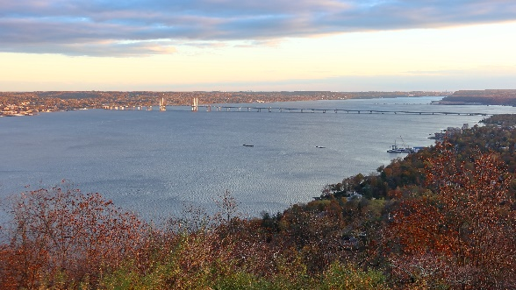
The Salt Front:
How far up the estuary?
Generally…
Summer/early fall – salt front near Beacon-Newburgh Bridge
Spring – salt front near the Tappan Zee Bridge
Notes:
The dilute leading edge of salty seawater is called the salt front. (The US Geological Survey defines the salt front as being where chloride concentration reaches 100 mg/L, a standard set in studies of the salt front in relation to drinking water intakes.) CLICK Generally speaking, the salt front – indicated by the red line - is located in the Tappan Zee in spring. CLICK In late summer and early fall, the salt front pushes upriver approximately to the Beacon-Newburgh Bridge; the red line will move north to indicate that.

Slide 13
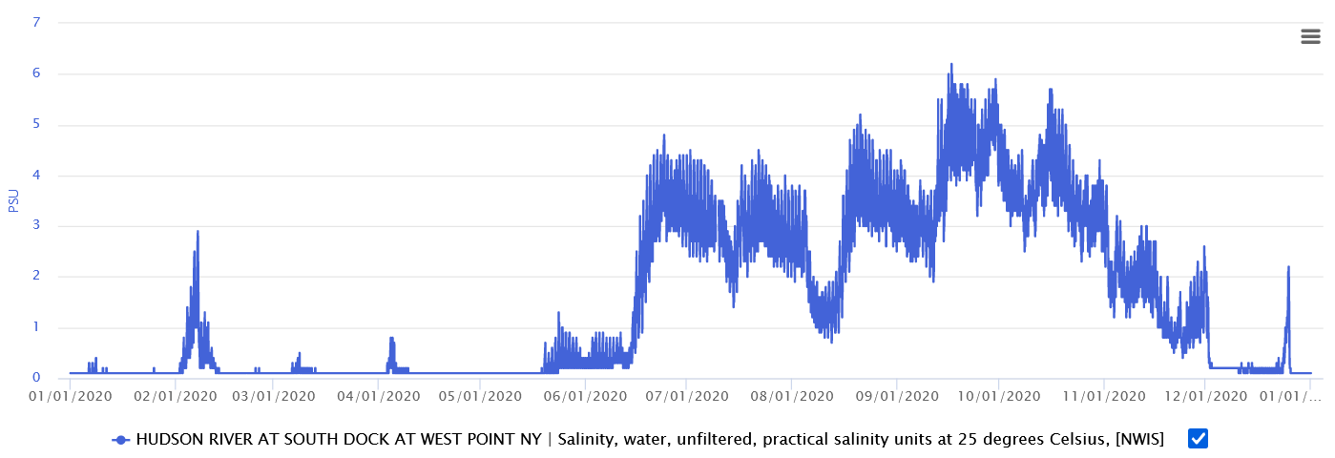
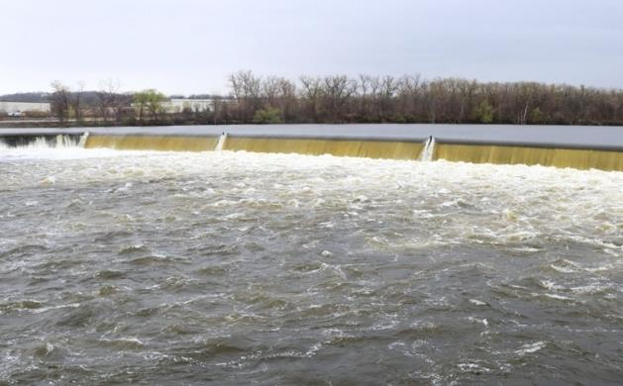
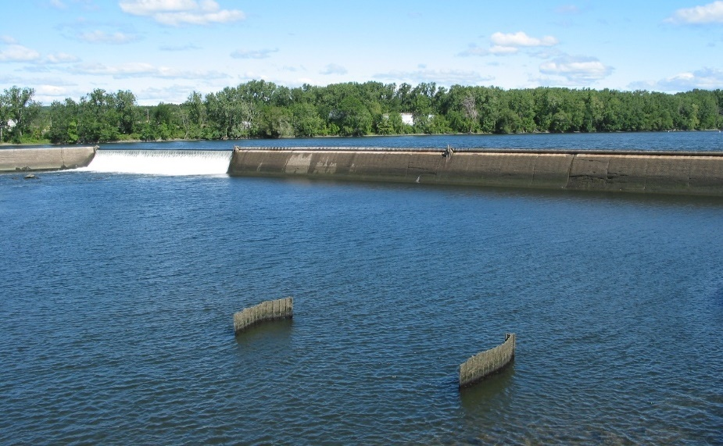
Runoff from the watershed determines the salt front’s location.
Spring
Summer/Fall
Chris Bowser
Notes:
Have students describe the pattern of salinity concentrations apparent in this HRECOS graph of salinity at West Point over the year 2020. CLICK to show photo of flow over the dam at Troy typical of late fall and spring, when rain and melting snow increase runoff from the watershed, pushing salty seawater towards the ocean. The sensors at West Point detect only occasional incursions of salt water then. CLICK to show photo of flow over the dam in summer and early fall. Runoff decreases then as these seasons usually have less rain and higher rates of evaporation, allowing dilute seawater to push upriver, as detected by the sensors at West Point then.

Slide 14
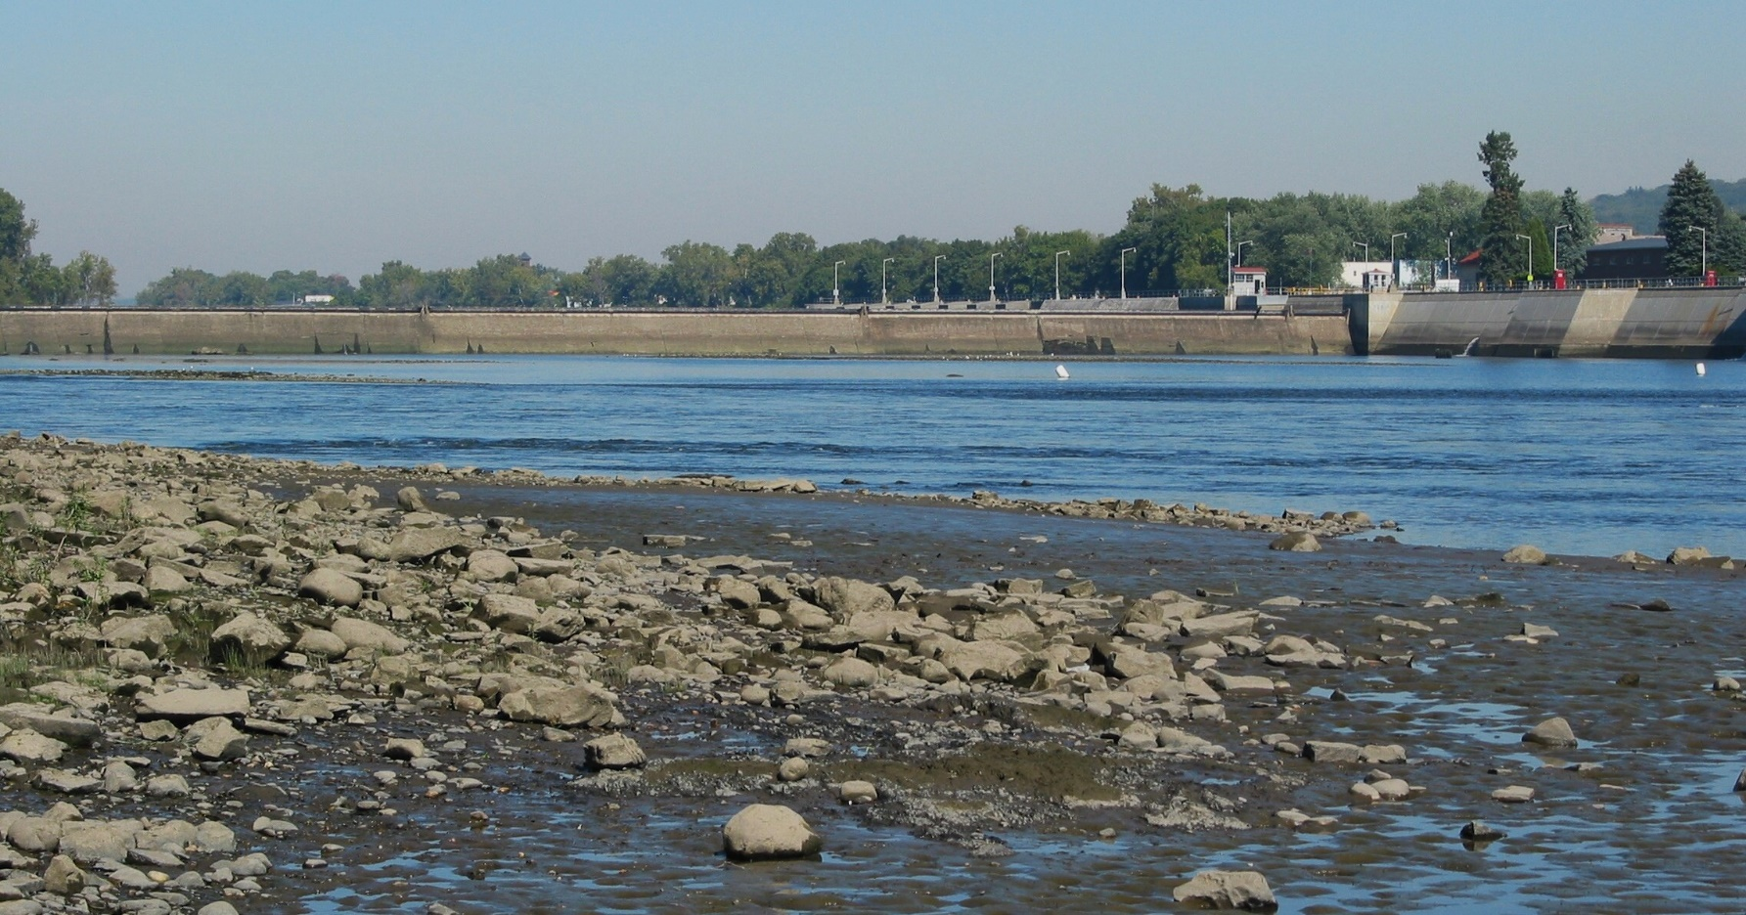
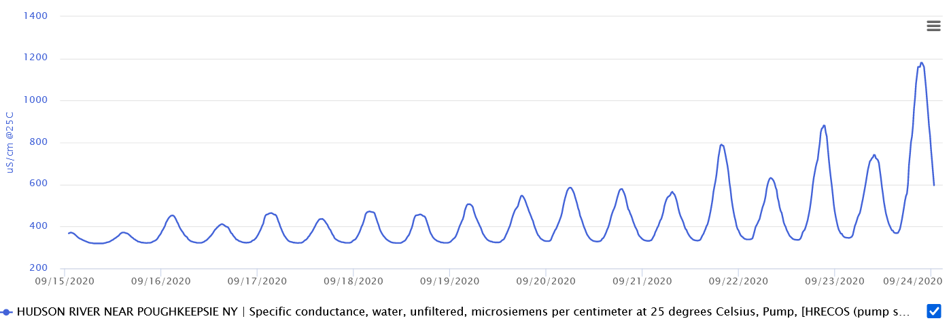
When drought in the watershed limits runoff,
ocean salt may reach Poughkeepsie.
Notes:
There can be great variation in the timing and extent of salt water intrusion. This photo shows no water coming over the dam at Troy as might happen during droughts. (There is still water flowing downriver past the dam, being directed through a hydroelectric plant at the west end of the dam and a lock at the east end), CLICK In such conditions, diluted seawater may reach Poughkeepsie, as shown in this HRECOS graph from September 2020. Note: This graph shows specific conductance, a measure of the water’s ability to conduct electricity; it increases as water gets saltier and is useful in showing the presence of low concentrations of salt. At 25 degrees C , 1000 µS/cm roughly equals a salinity of 0.55 parts per thousand (or PSU).

Slide 15
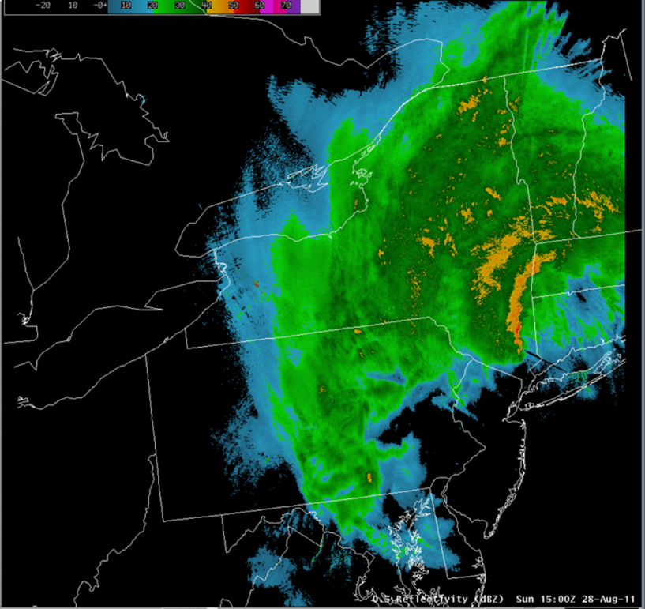
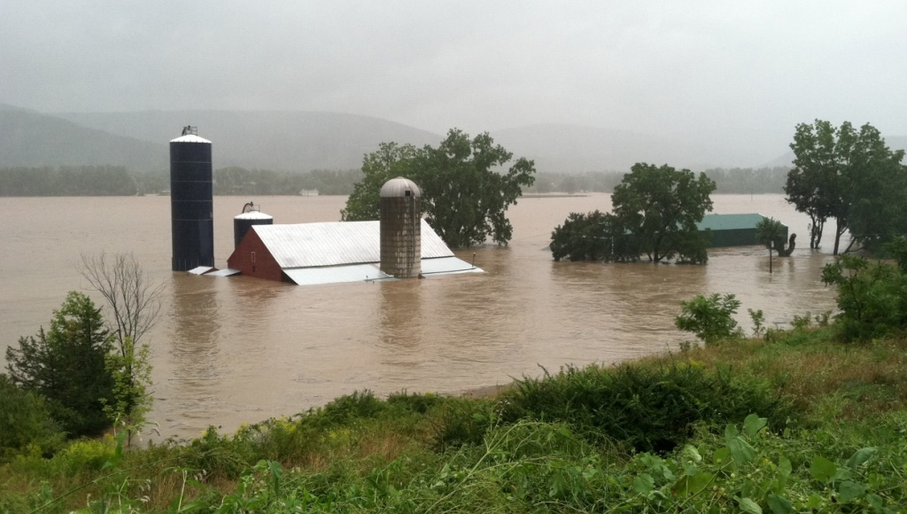
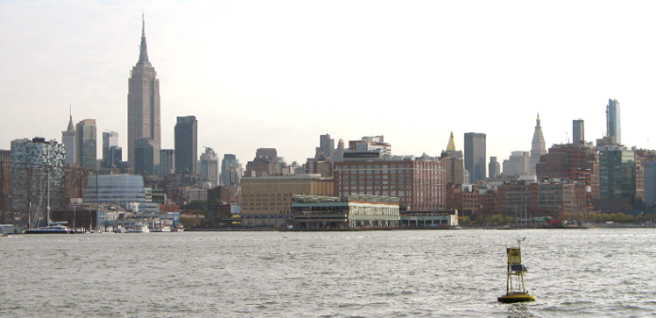
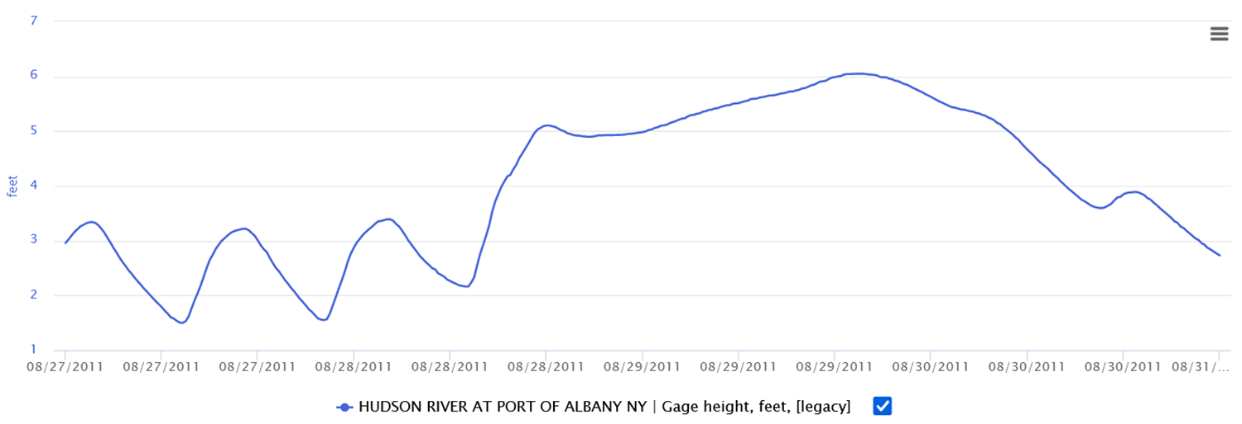
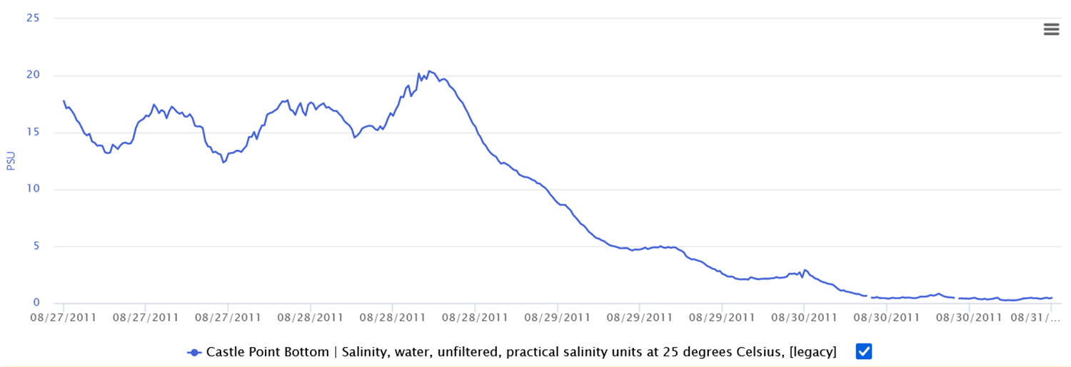
After intense rainstorms, runoff may push salt far down the estuary.
Tropical Storm Irene (2011)
Heavy rain over the Hudson’s watershed
Major flooding and runoff to the Hudson
National Resources Conservation Service
NOAA
Notes:
Radar image showing rainfall during Tropical Storm Irene in late August 2011. CLICK Very heavy rain, indicated by areas of yellow and red in this image, fell on the Hudson Valley and the watershed. CLICK The resulting runoff caused massive flooding. The photo is from the Schoharie River valley, through which runoff from the Catskills entered the Mohawk River and flowed on to the Hudson. CLICK to see HRECOS graph showing water levels rising at Albany following the storm. CLICK The runoff from Irene pushed salt water out of the Hudson. This HRECOS graph from sensors off Castle Point in Hoboken NJ (photo of the buoy on which the sensors are mounted) shows salinity falling to zero. Note that it took a few days for the mpacts of the runoff to be felt way downriver off New York City.

Slide 16
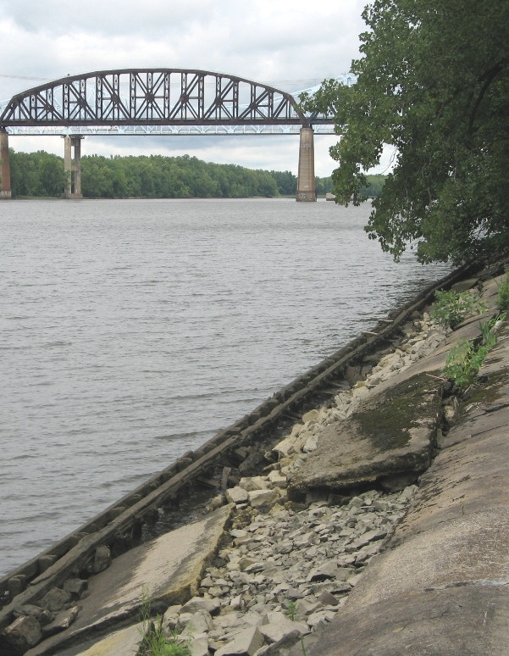
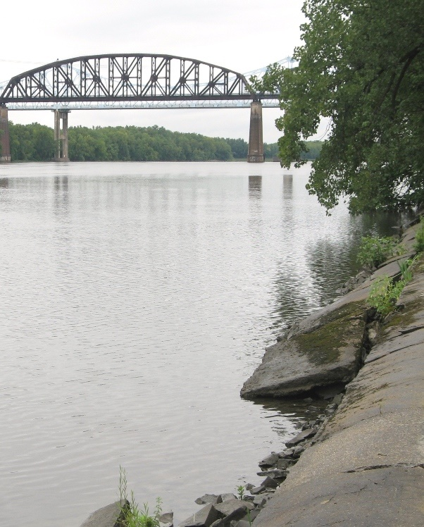
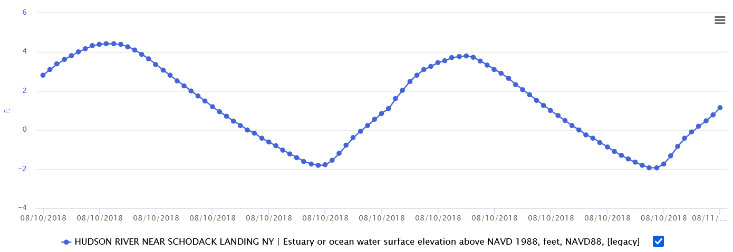
Another influence of the ocean: Tides.
Usually two high tides & two low tides daily.
Low tide at Schodack Island
High tide at Schodack Island
Notes:
Since the Hudson estuary is close to sea level, its water levels are set mostly by ocean tides. The photo shows low tide at Schodack Island, about 15 miles south of Albany. CLICK to view photo of high tide at Schodack Island. CLICK to view HRECOS graph of tides at Schodack Island, showing the typical pattern of two high tides and two low tides each day.

Slide 17


Rooted plants must adapt to being high & dry part of the time and underwater part of the time.
Notes:
Spatterdock grows in the intertidal zone, where it alternates between being out of the water during low tides and CLICK submerged during high tides.

Slide 18
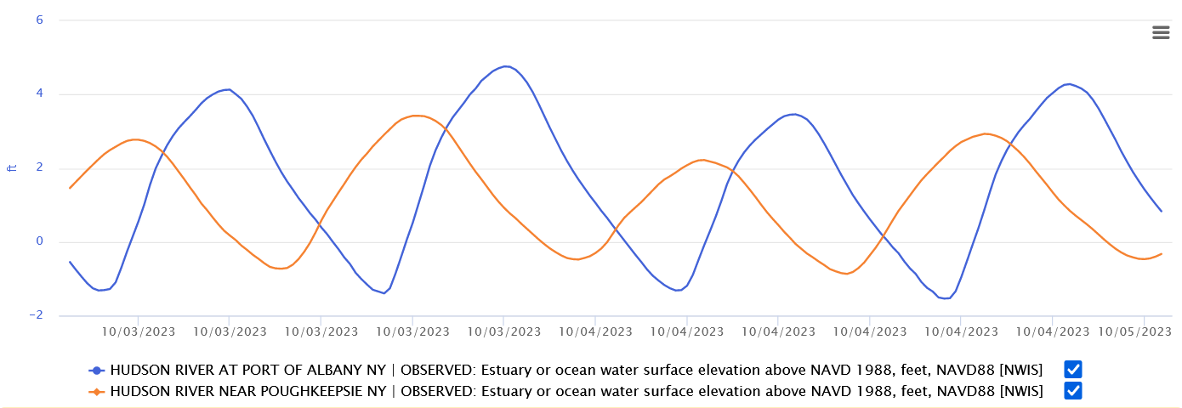
Ocean tides travel up the estuary to Albany & Troy.
Tides are more extreme at Albany – highs are higher and lows lower.
How does the plot of tides at Albany differ from the plot for Poughkeepsie?
Any given high or low tide at Poughkeepsie will occur later at Albany.
Notes:
This HRECOS graph shows tides at Poughkeepsie in orange and at Albany in blue. How does the plot of tides at Albany differ from the plot for Poughkeepsie? Allow students to propose various hypotheses before continuing. Encourage them to find at least two differences. By studying the pattern of each plot, it’s evident that a given high or low tide happens later in Albany than in Poughkeepsie. CLICK to see offsets. The estuary’s tides are generated in the ocean and travel up the river. It takes roughly four hours for a given high tide to travel from Poughkeepsie to Albany. Tides are also more extreme in Albany; CLICK 2X to clear offsets and then show that the high tides there are higher and the low tides lower than at Poughkeepsie. Tides travel up the river as an extended wave; as the channel becomes shallower and narrower towards Troy, the crest of the high tide is forced upward, as happens with an ocean wave coming onto a beach.

Slide 19
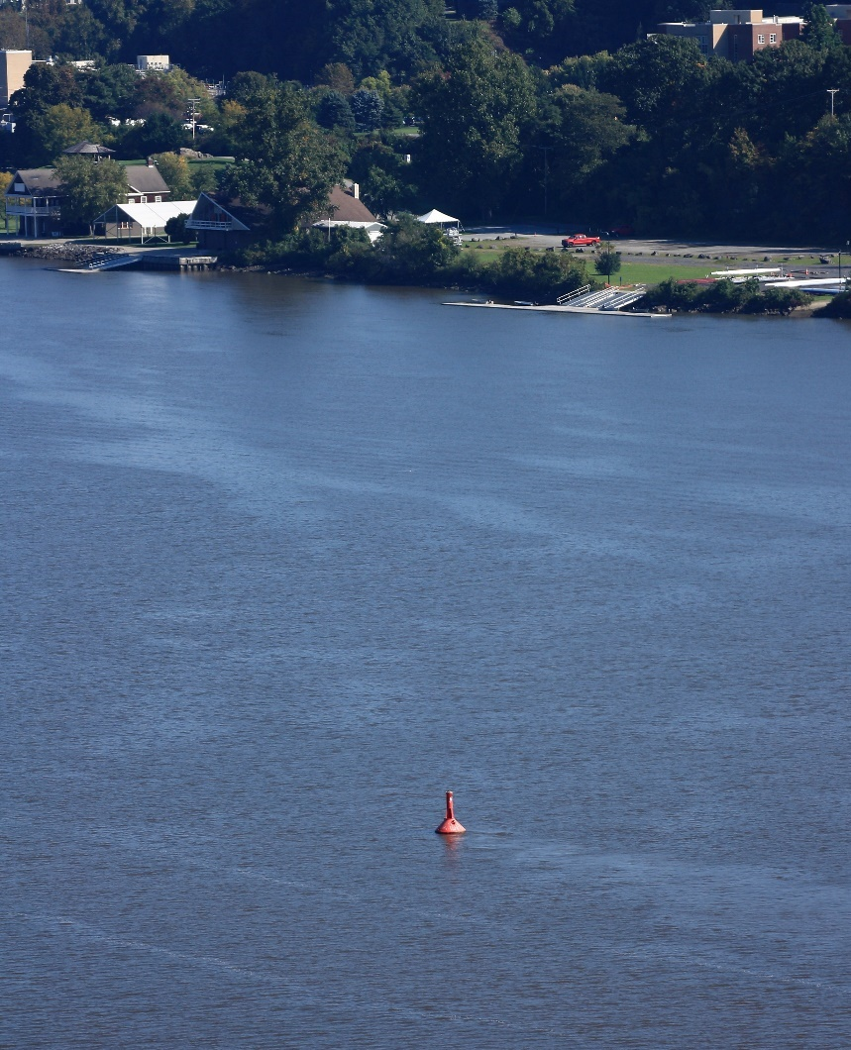

Tides cause the estuary’s currents to switch direction about every six hours.
Flood current
Ebb current
Mahicantuck: The River That Flows Both Ways
Notes:
Tides cause the estuary’s currents to switch direction about every six hours. The photo shows a navigation buoy off Poughkeepsie. The eddies streaming to the left of the buoy indicate the current is moving in from the ocean. An animated red arrow highlights this flow, called a flood current. CLICK to see the same buoy with eddies streaming to the right in a current moving towards the ocean. Another red arrow highlights this flow, called an ebb current. Indigenous people living along the estuary had a number of names for this waterway, one of which was Mahicantuck (spelled in various ways). Loosely translated, it means “great water in constant motion” or “river that flows both ways.”

Slide 20

Tidal currents stir up mud,
contributing to turbidity in the estuary.
Notes:
Tidal currents stir up mud from the bottom, contributing to turbidity in the estuary. While turbidity is sometimes simply defined as the muddiness of the water, plankton and small particles of decaying organic matter also contribute to turbidity.

Slide 21

The stronger the tidal currents, the more mud they stir up, increasing turbidity.
Notes:
The stronger the tidal currents, the more mud they stir up, increasing turbidity. This HRECOS graph from Albany from 8/26/23 to 9/8/23 plots water velocities (in orange) in feet per second vs turbidity (in blue). Velocity values below zero indicate an ebb current; values above zero indicate a flood current. CLICK to reveal three red arrows in succession; they highlight the range of current velocities over the time period, with the swiftest currents occurring around 8/31-9/2. CLICK again to show a green plot highlighting an increase in turbidity around the time of the greatest current velocities. Note: HRECOS reports turbidity in Formazin Nephelometric Units (FNU), which measure the degree to which light is scattered by particles suspended in a liquid. These are not directly comparable to the readings in centimeters obtained by using a secchi disc or turbidity tube.

Slide 22



Tributaries carry sediment from the watershed
into the Hudson, especially after heavy rains.
Tom Lake
Notes:
Tributaries carry sediment from the watershed into the Hudson, especially after heavy rains. The photo shows Cohoes Falls on the Mohawk River, the Hudson’s largest tributary. CLICK to see Cohoes Falls swollen and muddy with runoff immediately after Tropical Storm Irene. CLICK to show HRECOS graph at Albany during and after Irene. It plots precipitation (in orange) and turbidity (in blue) and shows turbidity, mainly from the Mohawk, arriving in Albany in the days following the storm.

Slide 23

Turbidity, living organisms, & temperature all influence the amount of oxygen dissolved in water.
As temperature goes up in spring and summer, dissolved oxygen levels drop. Cold water can hold more dissolved oxygen, so concentrations go up in fall and winter.
Let’s start with temperature. How do rising & falling water temperatures influence dissolved oxygen concentrations?
Notes:
Turbidity, temperature, and living organisms all influence the amount of oxygen dissolved in water. CLICK Let’s start with temperature. This HRECOS graph plots dissolved oxygen concentration (in blue) and water temperature (in red) over the year 2020 at Norrie Point. How do rising and falling water temperatures influence dissolved oxygen concentrations? CLICK As temperature goes up, dissolved oxygen levels drop, an example of an inverse relationship. Cold water can hold more dissolved oxygen than warm water.

Slide 24


Plants & animals influence dissolved oxygen levels.
How might living organisms cause dissolved oxygen concentrations to rise & fall every 24 hours?
Let’s add a plot of sunlight to the graph.
Notes:
Plants and animals influence dissolved oxygen levels. Ask students to describe the pattern shown in this HRECOS graph of dissolved oxygen concentrations from 9/5/23 through 9/7/23 at Schodack Landing. They peak in the afternoon and are lowest around dawn. CLICK How might living organisms cause dissolved oxygen concentrations to rise and fall in this pattern every 24 hours? Students may identify photosynthesis as the cause. To reinforce the point or provide a hint if needed, CLICK to add a plot of sunlight (photosynthetically active radiation) to the graph.

Slide 25



During the day, sunlight drives photosynthesis.
Dissolved oxygen levels rise.
Dissolved oxygen levels fall.
When it’s dark, respiration by living organisms takes up oxygen.
Notes:
During the day, sunlight drives photosynthesis by plants and phytoplankton, and dissolved oxygen levels rise. The photo shows sunlight illuminating bed of submerged plants (water celery). CLICK again to darken image and make the point that when it’s dark, respiration by living organisms causes dissolved oxygen levels fall.

Slide 26




Back to turbidity – how would muddier water influence dissolved oxygen concentrations?
Mud blocks sunlight, limiting photosynthesis.
Notes:
The HRECOS graph from 9/9/23 through 9/10/23 at Schodack Landing shows a sharp peak in turbidity starting 9/9. Ask students to predict what will happen to dissolved oxygen levels as a result of that increase and explain their prediction. CLICK to add a plot of dissolved oxygen saturation (saturation is a measure of the actual dissolved oxygen concentration as a percentage of what it theoretically should be at the observed water temperature). The accompanying photo shows turbidity increasing in the river. CLICK Mud blocks sunlight, limiting photosynthesis.

Slide 27


Are conditions in the Hudson estuary changing over time – perhaps due to climate change?
Data compiled by David Seekell & Mike Pace, Cary Institute of Ecosystem Studies. Journal of Environmental Monitoring, 2011
Yes, water temperature has risen over the years.
Notes:
Are conditions in the Hudson estuary changing over time – perhaps due to climate change? This graph of water temperature at Poughkeepsie gives part of the answer. CLICK Yes, the estuary is warming due to climate change.

Slide 28


Data from Long River Utilities Survey
Atlantic tomcod
Tomcod prefer cold water and became less abundant over the period shown.
Notes:
Warming water temperatures are having an impact on life in the river. This graph of the index of abundance for the Atlantic tomcod provides some evidence. Ask students what the graph says about tomcod numbers. While increasing water temperatures may not be the only reason for the decline shown in the graph, the tomcod is a cold-water fish. The Hudson is the southernmost river in which tomcod spawn, laying their eggs in winter, often under ice. It may become impossible for them to survive in the warming Hudson.

Slide 29

Has climate change influenced water levels in the Hudson estuary?
Storms have become more intense, with heavier rain & stronger winds.

Slide 30


Has climate change influenced water levels in the Hudson estuary?
“Superstorm” Sandy
What might have caused the peak in water level at the Battery on 10/29/2012?
NOAA
Notes:
Has climate change influenced water levels in the Hudson estuary? This National Oceanic and Atmospheric Administration (NOAA) graph has two plots of water levels at the Battery from 10/28/12 through 10/31/12. The blue plot shows predicted water levels based on the relative positions of the earth. Moon, and sun – the main factors driving tides. The green plot shows the actual water levels during that period, including a dramatic peak on 10/29/2012. What might have caused this peak? CLICK to see satellite image of Superstorm Sandy. While Tropical Storm Irene caused water levels to rise over several days due to runoff from heavy rain, Sandy caused a relatively brief peak driven by strong winds. This is called storm surge.

Slide 31



South Ferry subway station, NYC. Image credit: MTA
Manhattan blackout and flooding images by Hudson River Park Naturalist Keith Michael
Were there impacts further upriver? How far did Sandy‘s storm surge go?
Sandy’s storm surge caused severe flooding in NYC.
Notes:
Sandy’s storm surge flooded subway tunnels and parts of lower Manhattan, causing blackouts and – in Queens and Staten Island – loss of lives. CLICK Were there impacts further upriver? How far did the storm surge go?

Slide 32



Gregg Swanzey
NYSDEC
The graph shows storm surge peaks in Poughkeepsie and Albany.
Storm surge damage in Stony Point
Storm surge flooding in Kingston
Notes:
This HRECOS graph shows water levels at Poughkeepsie (in orange) and Albany (in red) during roughly the same time period. Ask students Are there storm surge peaks in water level at these locations? CLICK Yes. Sandy’s storm surge rolled up the Hudson. CLICK It toppled these boats at a marina in Stony Point and CLICK flooded businesses in Kingston.

Slide 33

Climate change has raised sea level in New York Harbor about one foot in the last 100 years.
Sea level will rise more. Future storms – not as strong as Sandy – could cause similar or greater damage.
Notes:
This NOAA graph shows changes in sea level at the Battery in Manhattan since the mid 1800s. Climate change has raised sea level in New York Harbor about one foot in the last 100 years. Sea level will rise more, allowing future storms – even those not as strong as Sandy – to cause similar or greater damage. CLICK Adapting to higher water levels – by raising riverfront houses on pilings, for example – will be necessary.

Slide 34


Addressing Climate Change
Mitigation
Adaptation
Notes:
Addressing climate change along the Hudson will require CLICK adaptation to impacts already occurring, such as elevating riverside houses in Stony Point on pilings to minimize damage from flooding. Getting at the root causes of climate change will require mitigation CLICK here in the Hudson Valley and beyond. Examples include speeding up the changeover to renewable sources of energy and cutting back on the burning of fossil fuels that add to the carbon dioxide buildup responsible for warming the planet. Our actions today can reduce the future impacts of climate change.

Slide 35

As storms & other events occur, HRECOS sensors will record & report their impacts on the Hudson.
https://hrecos.org
Notes:
As storms and other climate change related events occur, HRECOS sensors will record and report their impacts on the Hudson.
When showing this PowerPoint while connected to the internet, clicking on the URL at the bottom of this slide will link to the actual HRECOS interface, allowing users to create their own graphs.

Slide 36
Thank You!
For more information, please contact:
NYSDEC – Hudson River Estuary Program
21 South Putt Corners Road
New Paltz, NY 12561
845 256-3016
hrep@dec.ny.gov
Connect with us:
Facebook: www.facebook.com/NYSDEC
Twitter: twitter.com/NYSDEC
Flickr: www.flickr.com/photos/nysdec
Credits:
Produced in cooperation with the New England Interstate Water Pollution Control Commission & Hudson River National Estuarine Research Reserve.
PowerPoint created by Steve Stanne.
Unless otherwise credited, all photographs are by Steve Stanne.
Notes:
Contact information and credits.

Slide 37
Connect with us:
Facebook: www.facebook.com/NYSDEC
Instagram: @nysdec
Flickr: www.flickr.com/photos/nysdec
Notes:
Contact information and credits.

